Slide 1
Appendix

Slide 2
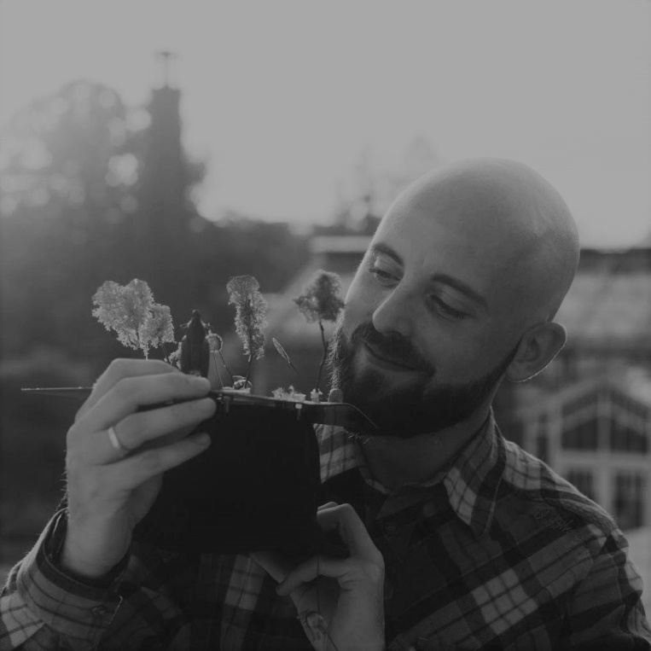
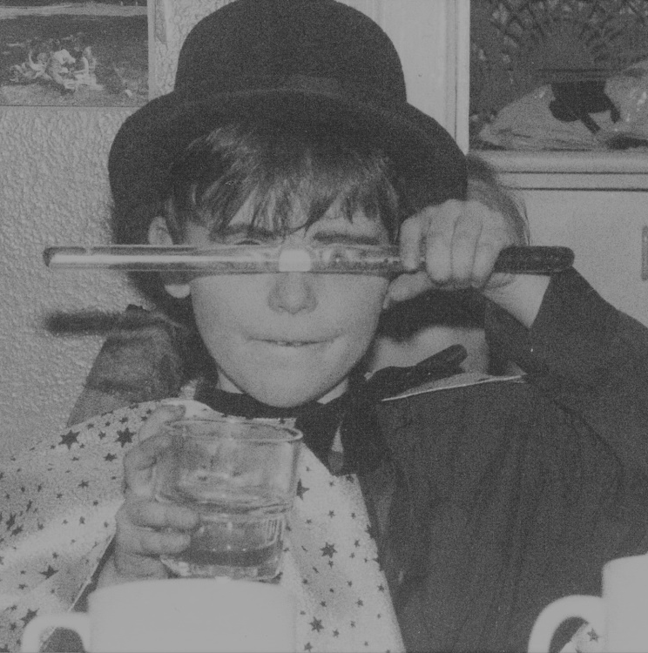
Scientist by Training
DataVizard by Heart
Computational Ecology at the Leibniz Institute for Zoo and Wildlife Research
Freelancing Data Visualization Designer & Workshop Instructor

Slide 3
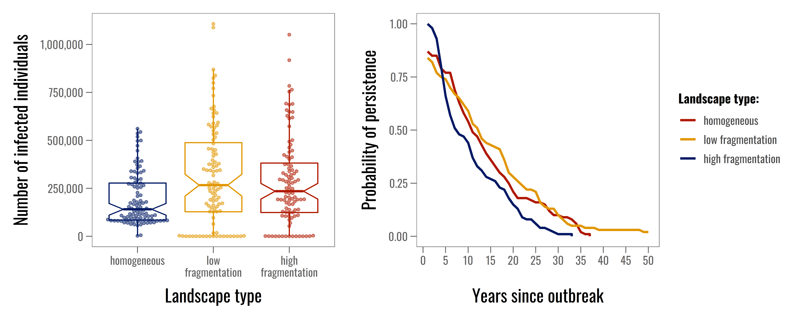
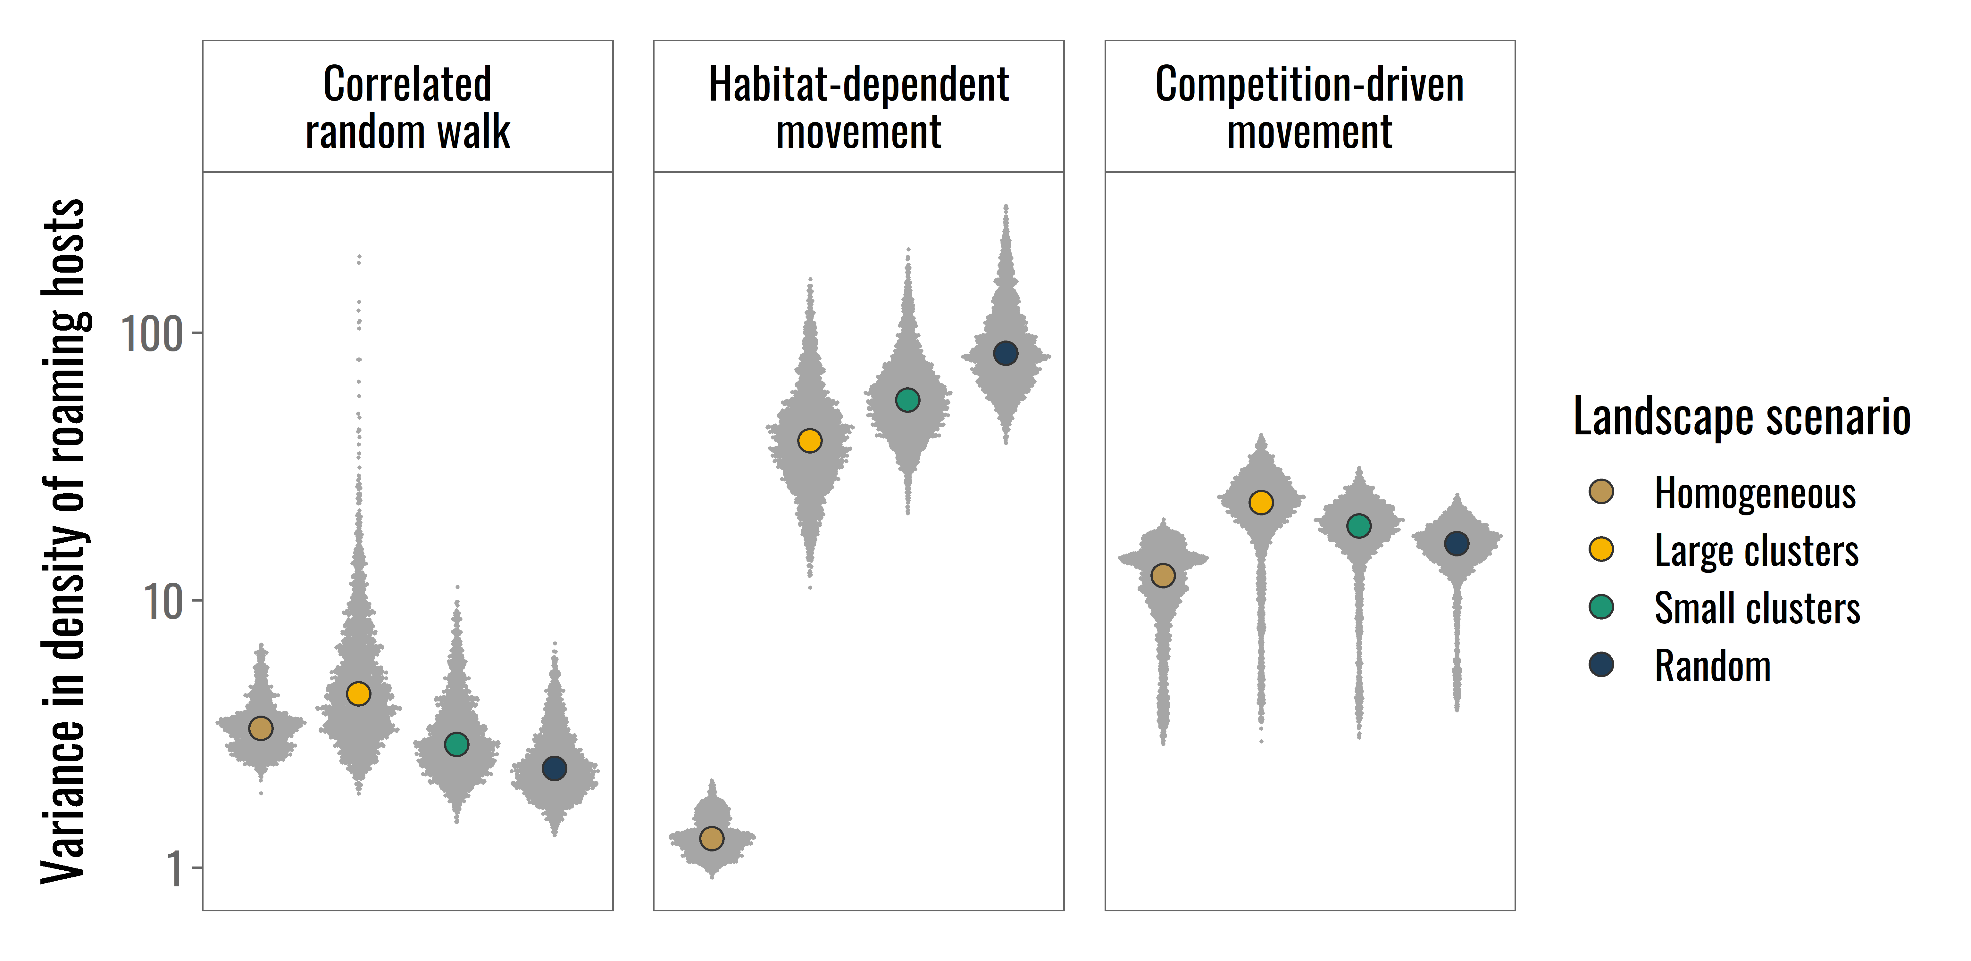
The Showcase
Top: Modified from Sciaini et al. 2018 Methods in Eoclogy & Evolution | Bottom: Modified from Scherer et al. 2020 Oikos

Slide 4
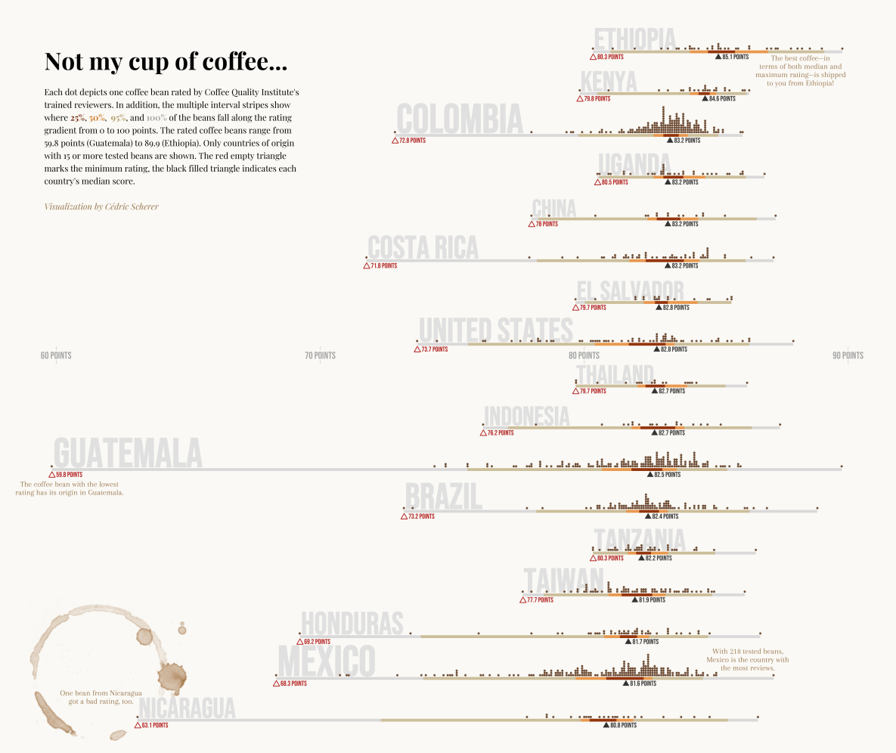
The Showcase
Contribution to #TidyTuesday 2020/28

Slide 5
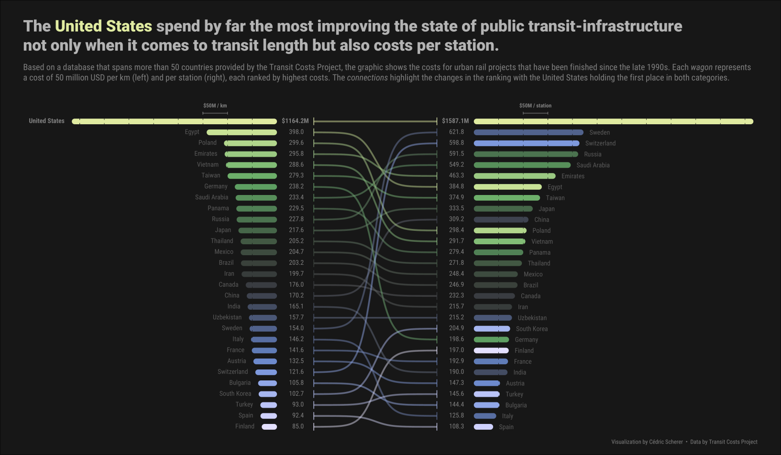
The Showcase
Bump Charts
with the help of
{ggbumb}
My Contribution to #TidyTuesday 2021/02
🔗 github.com/davidsjoberg/ggbump

Slide 6
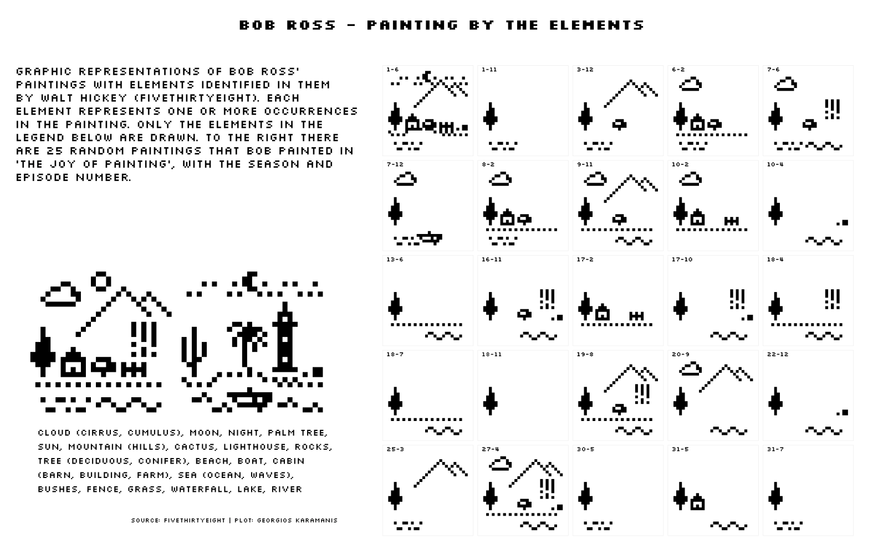
The Showcase
Pixel Art
Georgios Karamanis, #TidyTuesday 2019/32
Notes:
But also the ggplot2 package itself comes with a lot of possibilities to create unusual graphics such as this pixel art example by Georgios, …

Slide 7
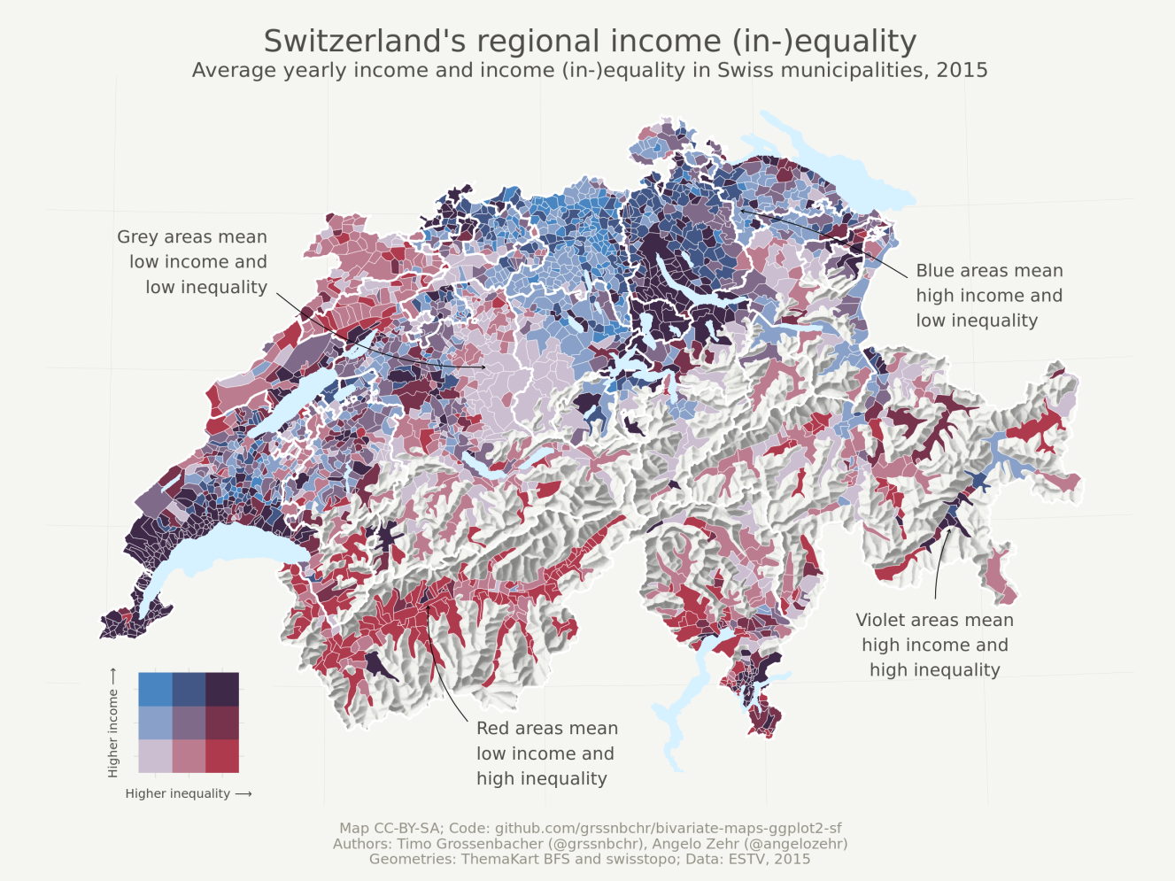
The Showcase
Bivariate Maps
can be done with
{biscale}
🔗 github.com/sjewo/cartogram
Timo Gossenbacher (timogrossenbacher.ch/2019/04/bivariate-maps-with-ggplot2-and-sf)

Slide 8
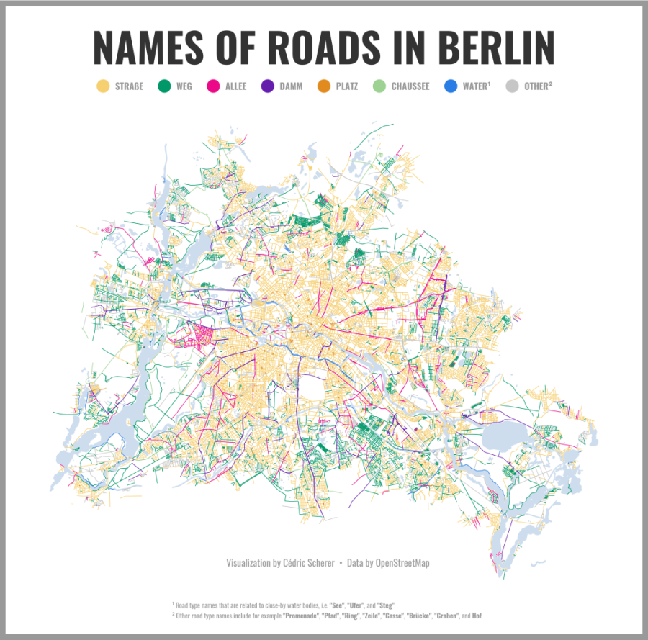
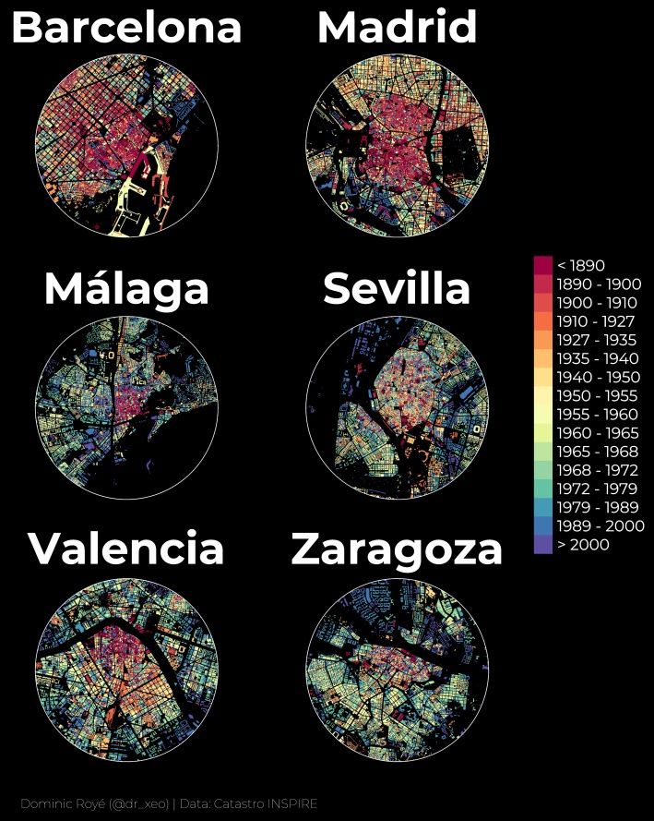
The Showcase
Maps
My Contribution to #30DayMapChallenge 2019 Topic Names
Dominic Royé (dominicroye.github.io/en/2019/visualize-urban-growth/)
with the help of
{sf}
🔗 r-spatial.github.io/sf

Slide 9
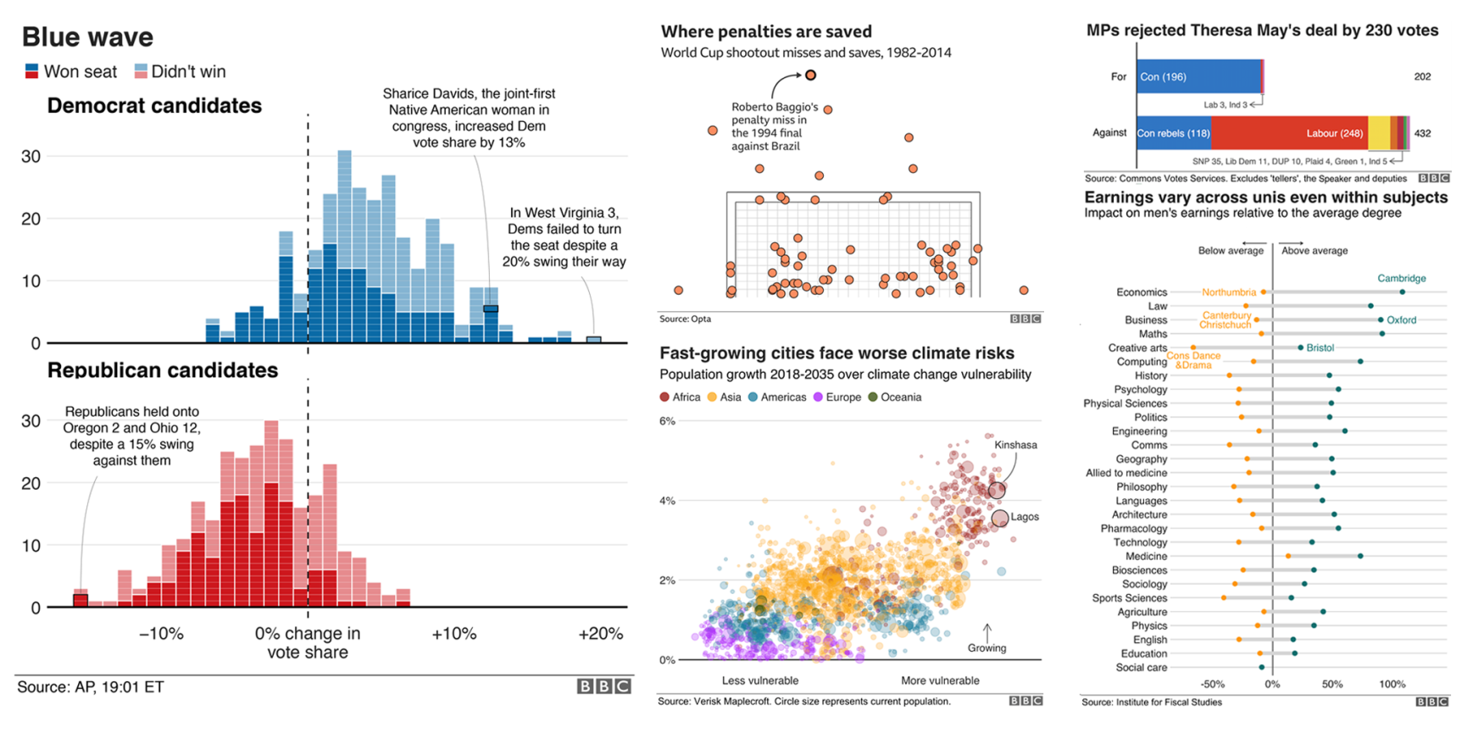
The Showcase
Consistent Theming
Collection of BBC Graphics (modified from bbc.github.io/rcookbook)

Slide 10
The Showcase
Consistent Theming + Reproducibility
“At the BBC data team, we have developed an R package and an R cookbook to make the process of creating publication-ready graphics in our in-house style using R’s ggplot2 library a more reproducible process.”
Collection of BBC Graphics (modified from bbc.github.io/rcookbook)

Slide 11
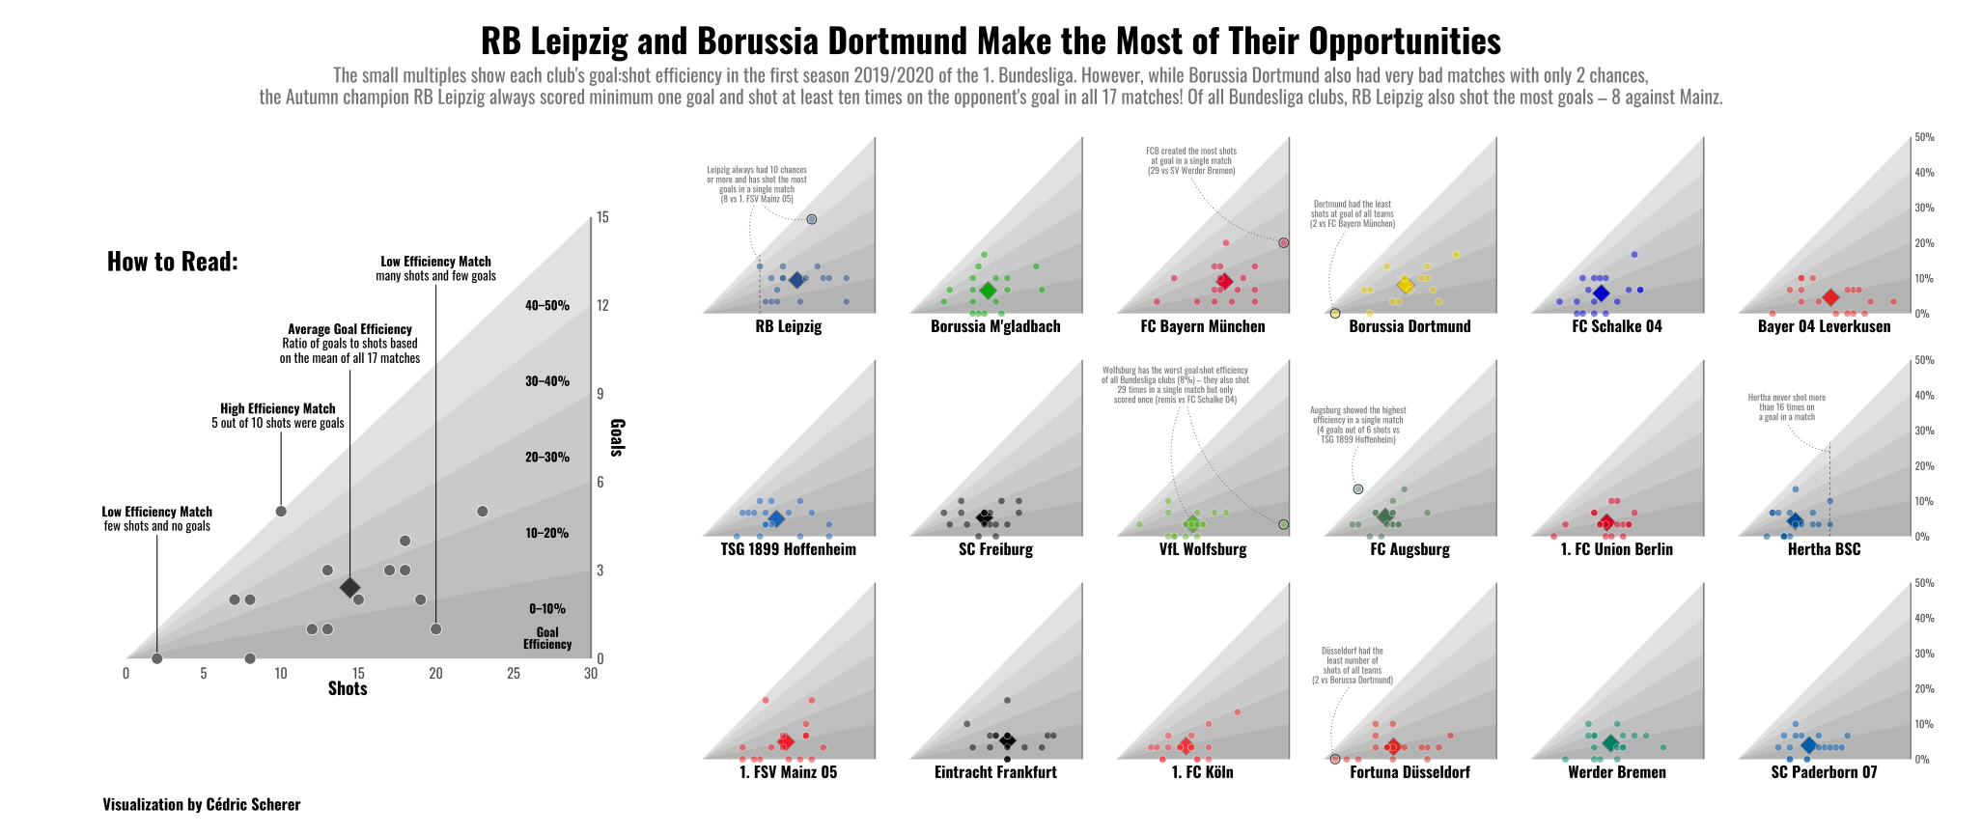
The Showcase
Small Multiples
My Contributin to SWD Challenge January 2020
Notes:
It is also powerful when it comes to small multiples, that show subsets of your data, thanks to the facet functionaility.

Slide 12
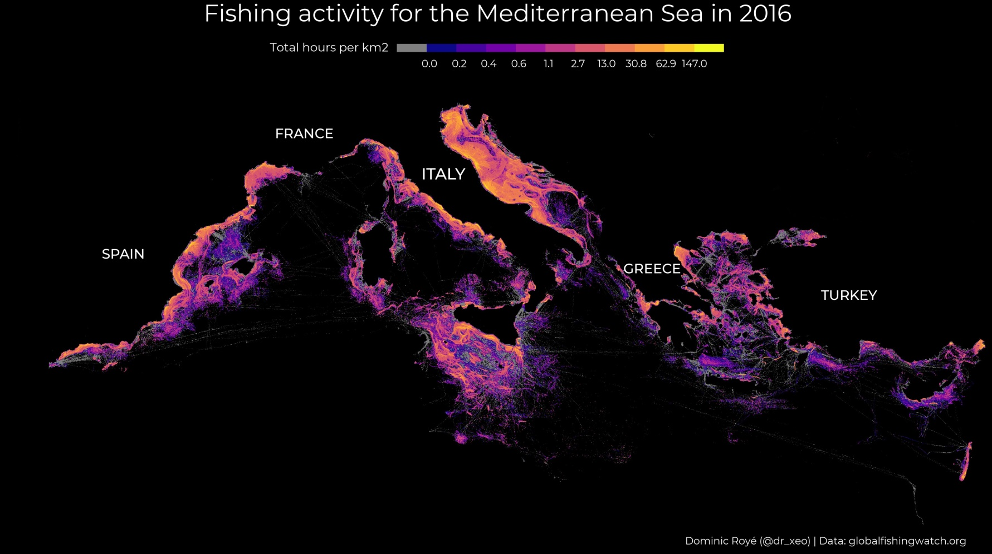
The Showcase
Dominic Royé

Slide 13
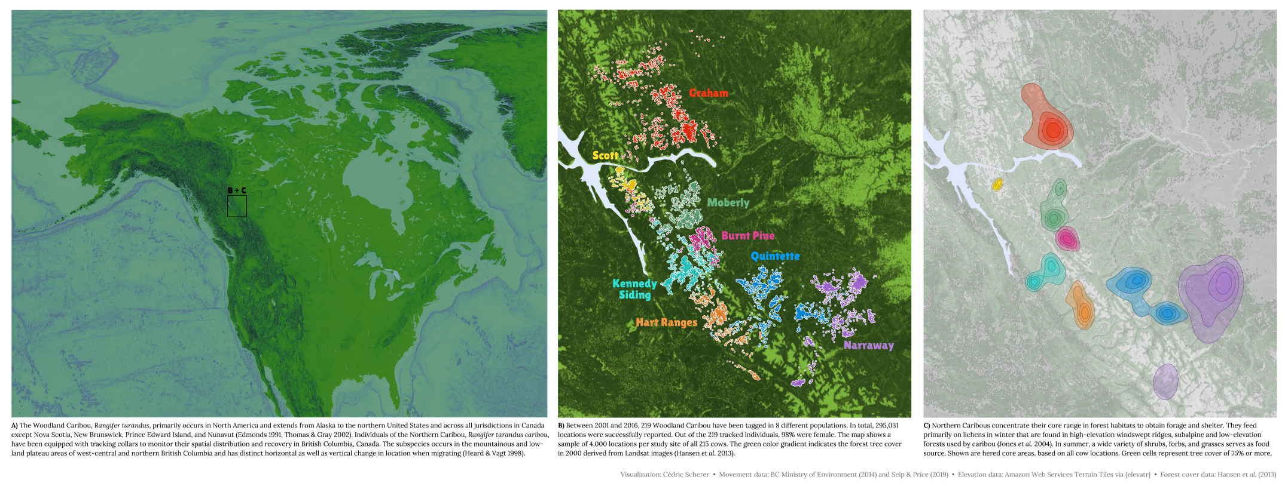
The Showcase
Hillshading
My Contribution to #TidyTuesday 2020/26

Slide 14

The Showcase
Data Art
Georgios Karamanis,

Slide 15
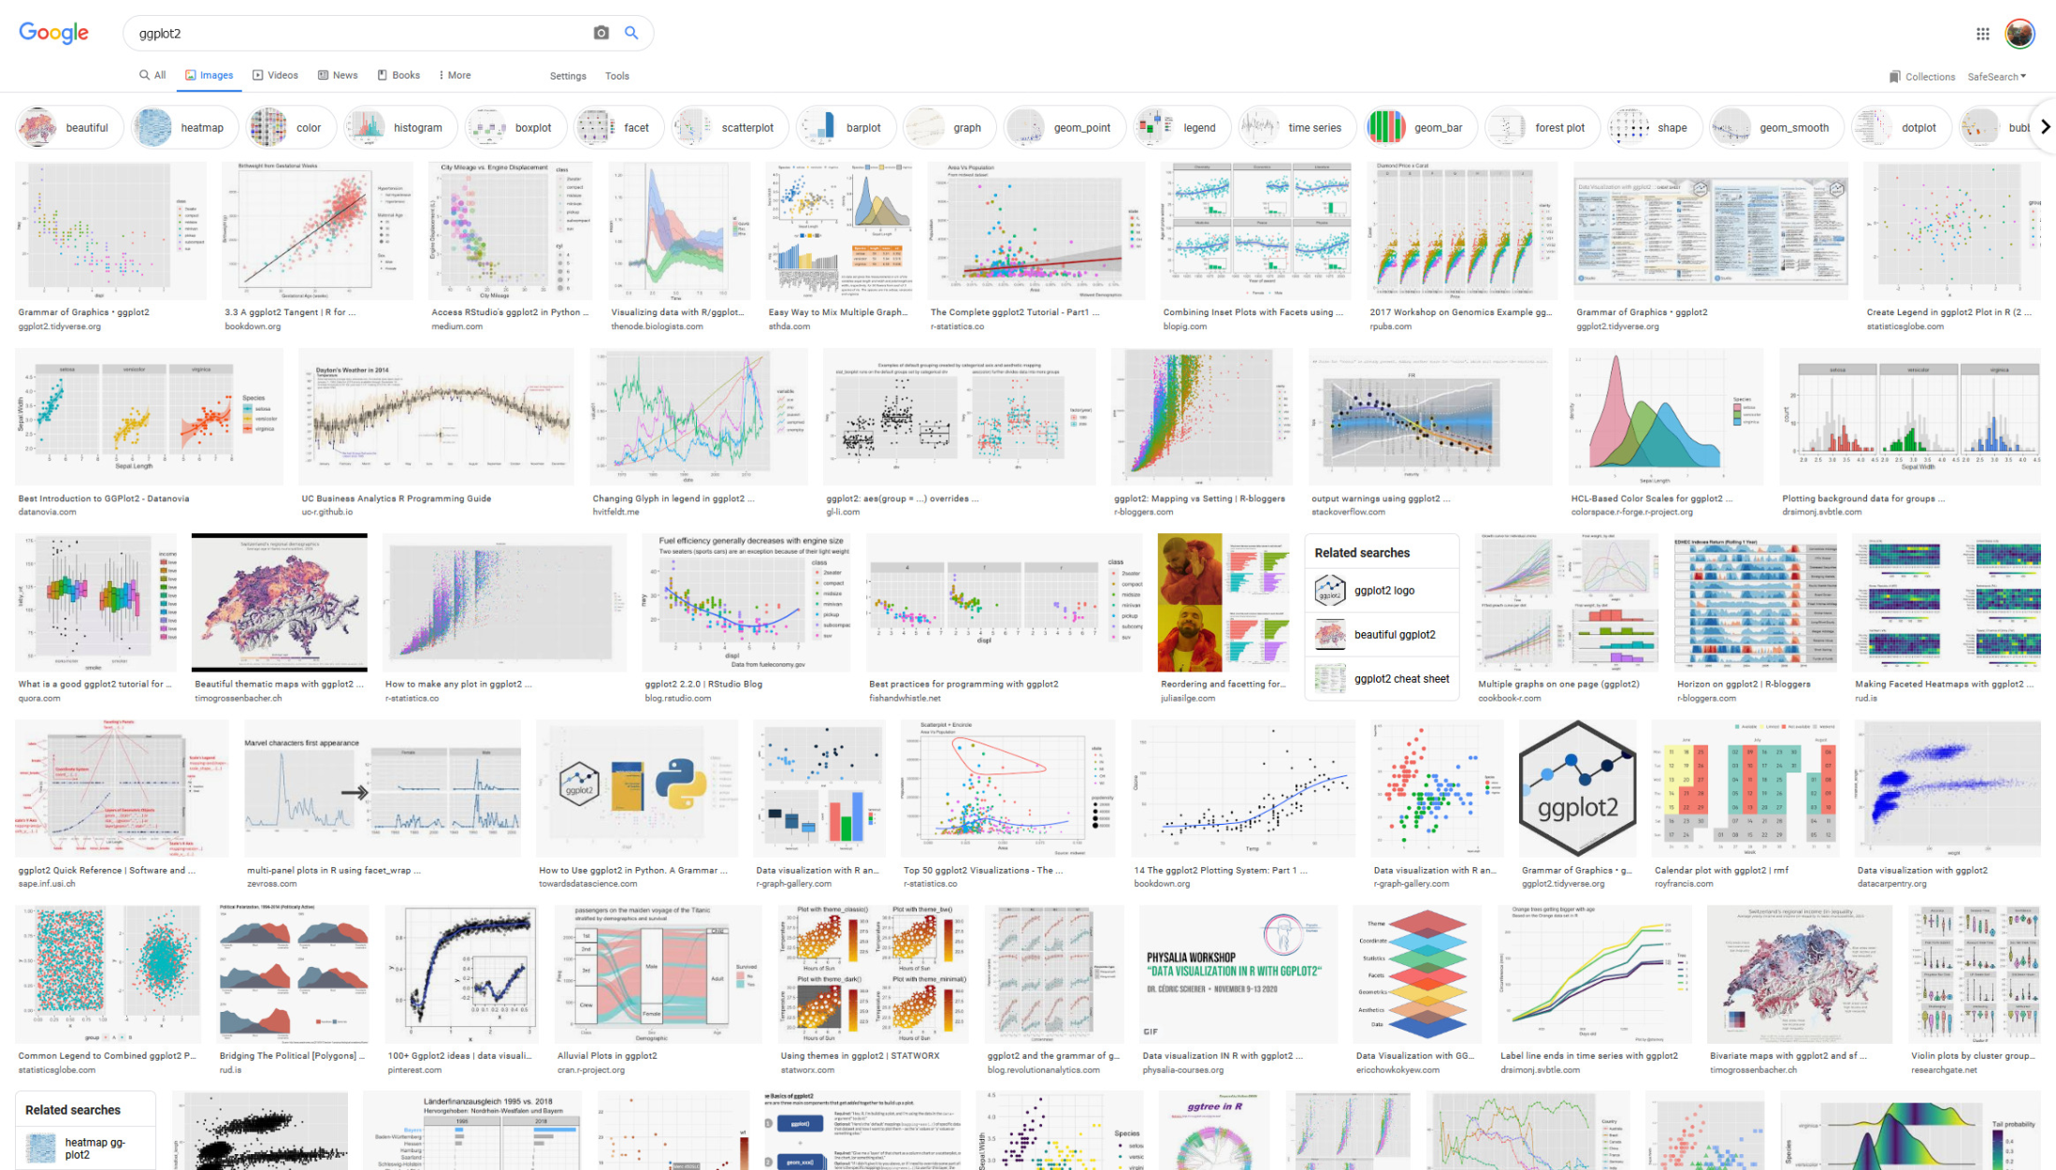

Slide 16
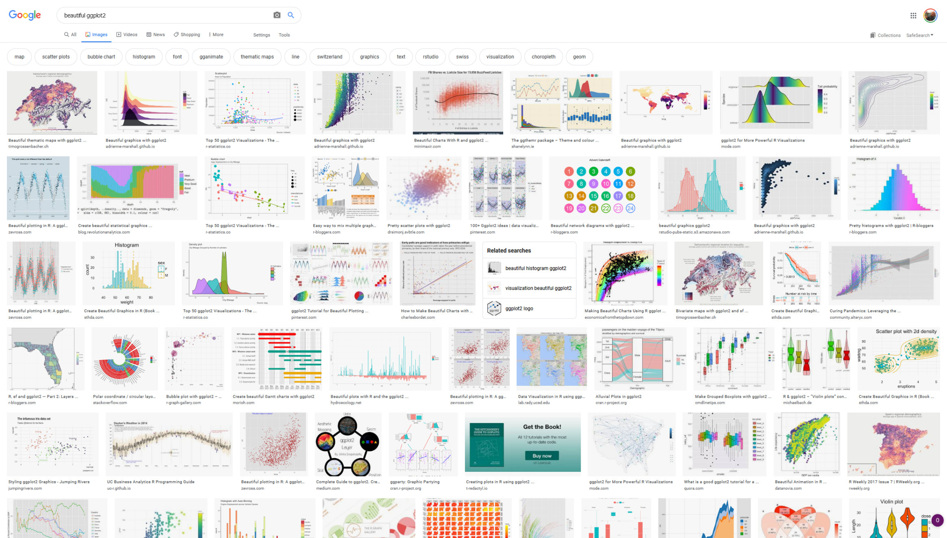

Slide 17
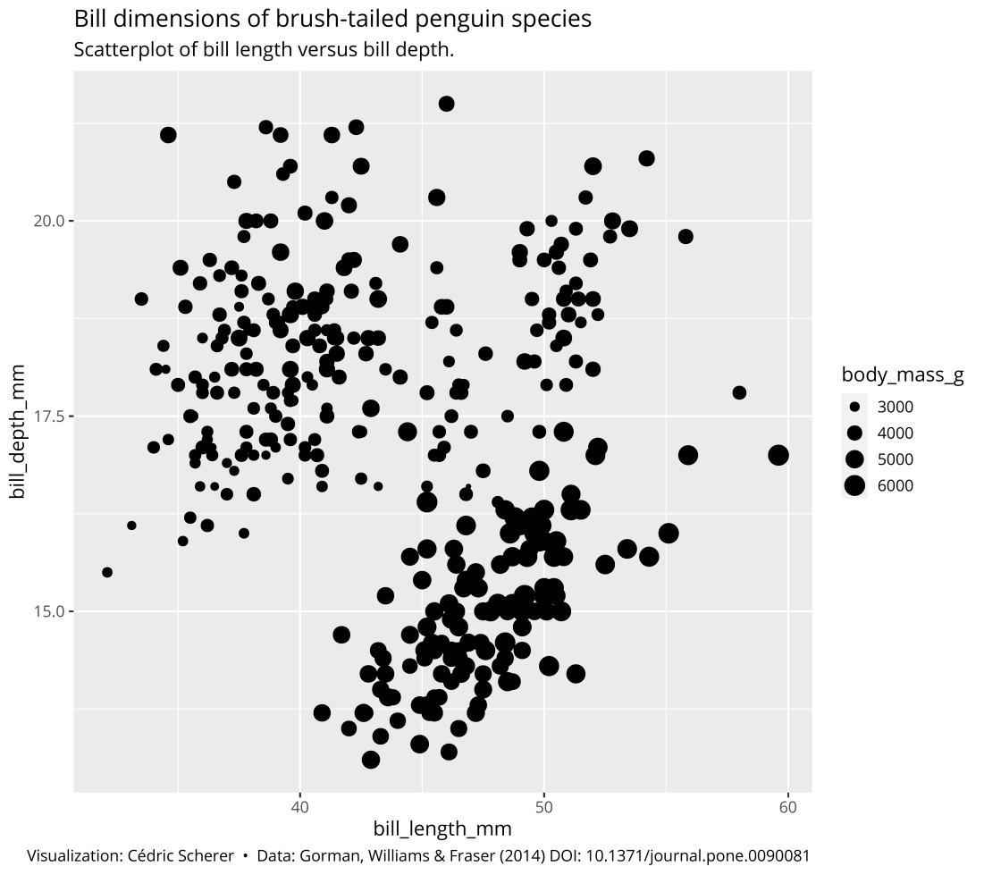
You provide the data, tell ggplot2 how to map variables to aesthetics, what graphical primitives to use, and it takes care of the details.

Slide 18
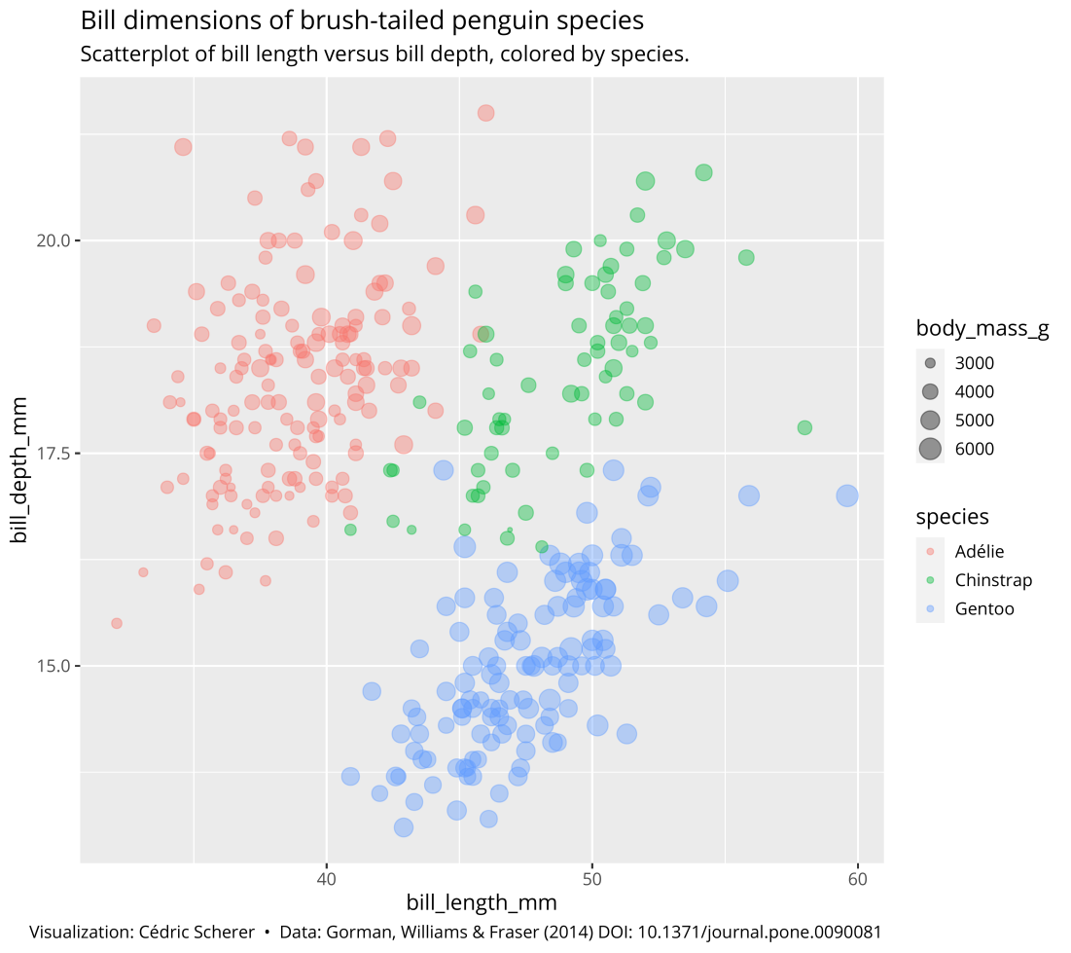
You provide the data, tell ggplot2 how to map variables to aesthetics, what graphical primitives to use, and it takes care of the details.

Slide 19
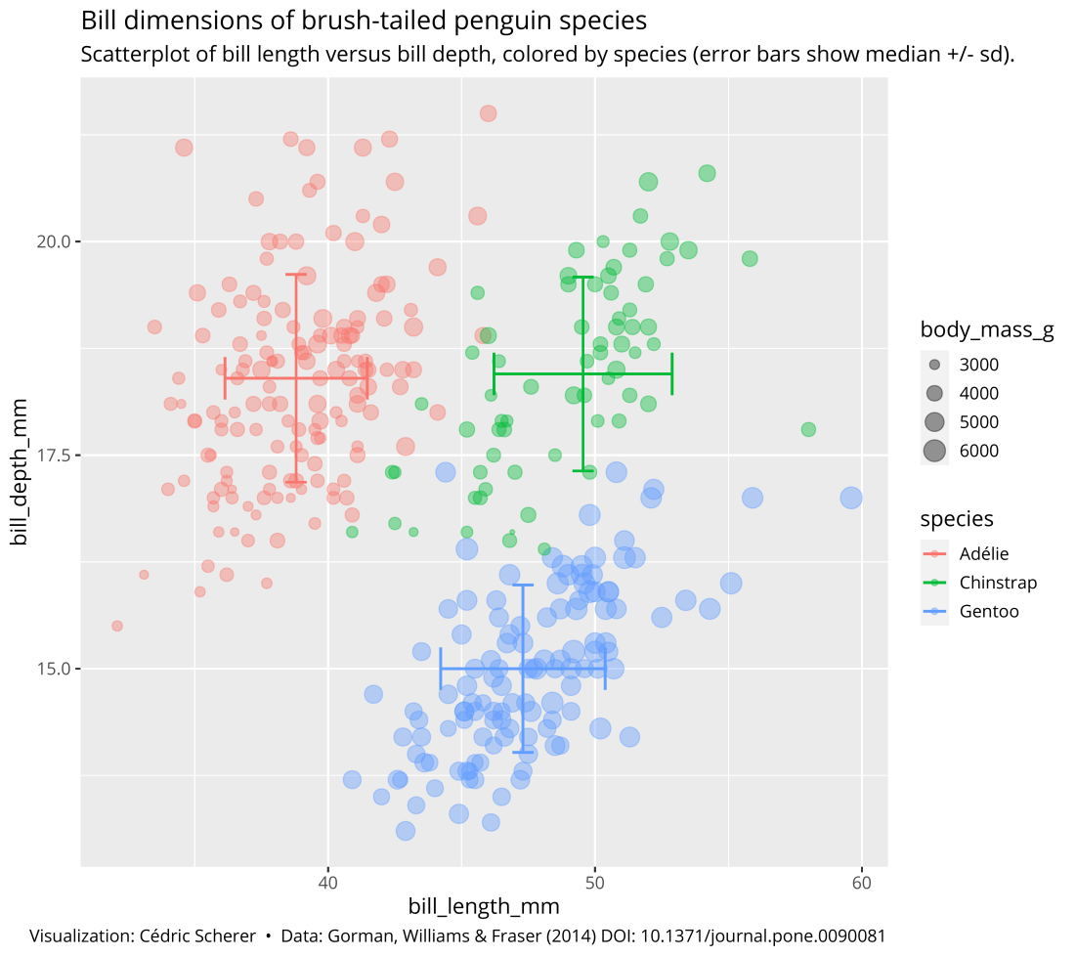
You provide the data, tell ggplot2 how to map variables to aesthetics, what graphical primitives to use, and it takes care of the details.

Slide 20
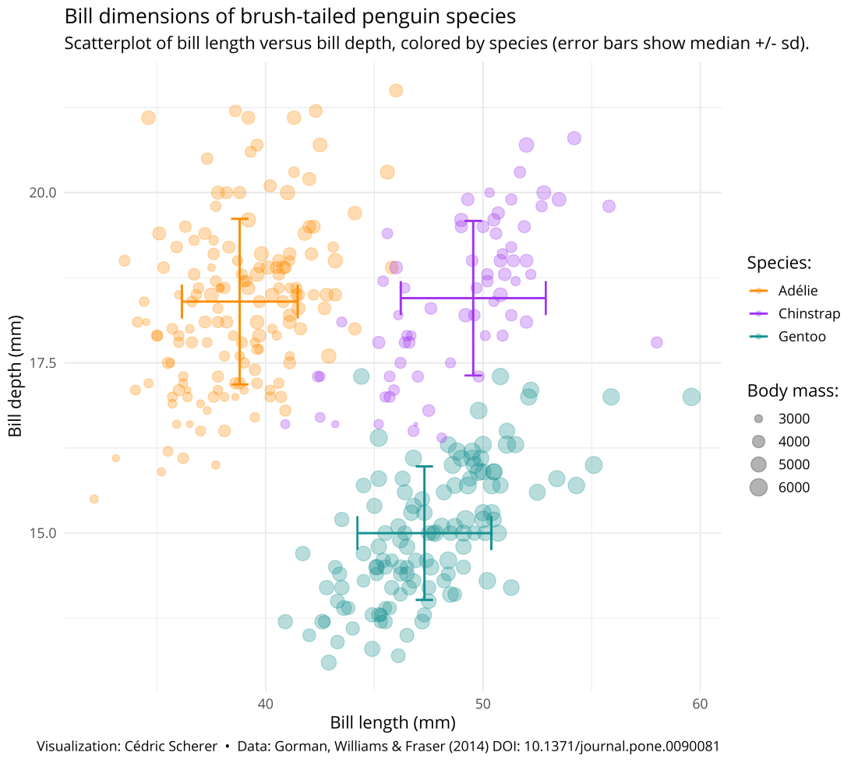
You provide the data, tell ggplot2 how to map variables to aesthetics, what graphical primitives to use, and it takes care of the details.

Slide 21
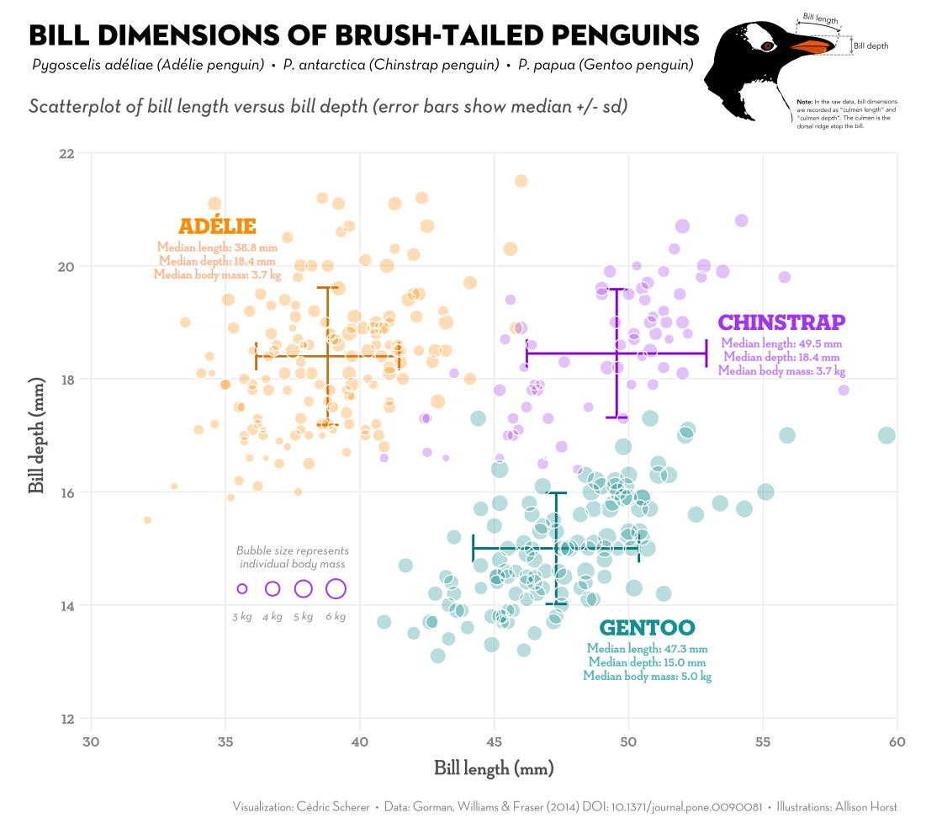
You provide the data, tell ggplot2 how to map variables to aesthetics, what graphical primitives to use, and it takes care of the details.

Slide 22
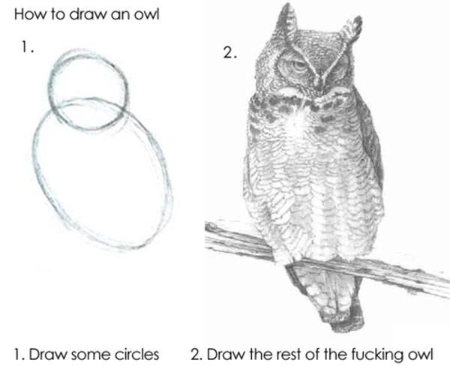
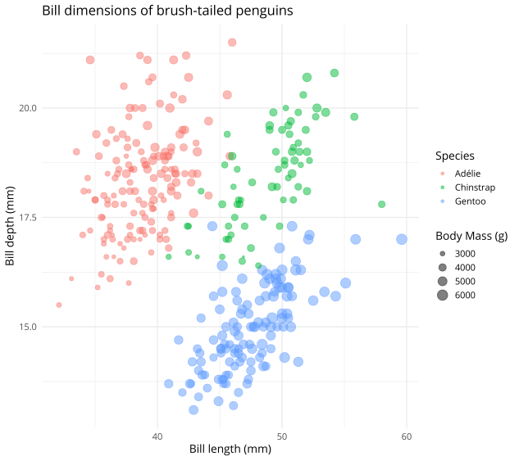
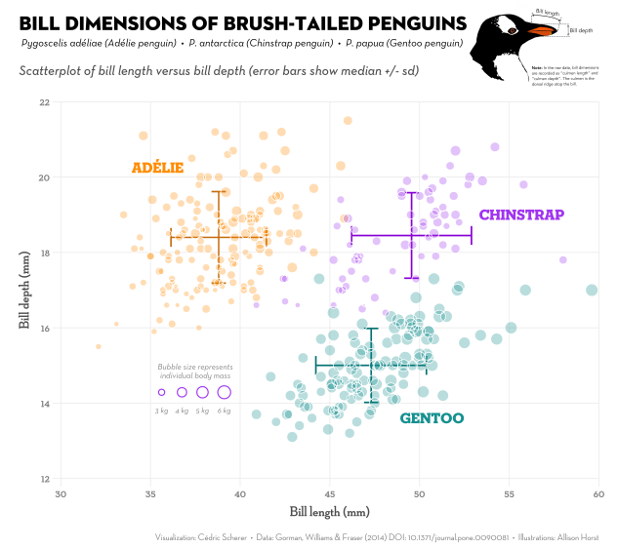
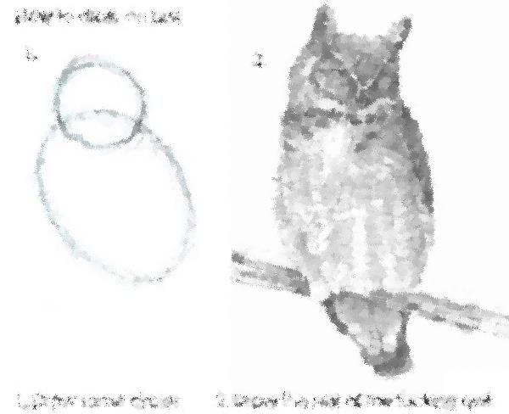

Slide 23
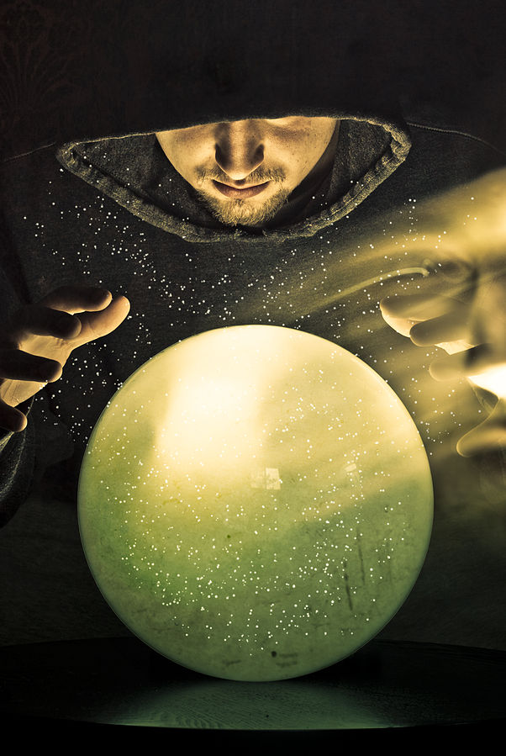
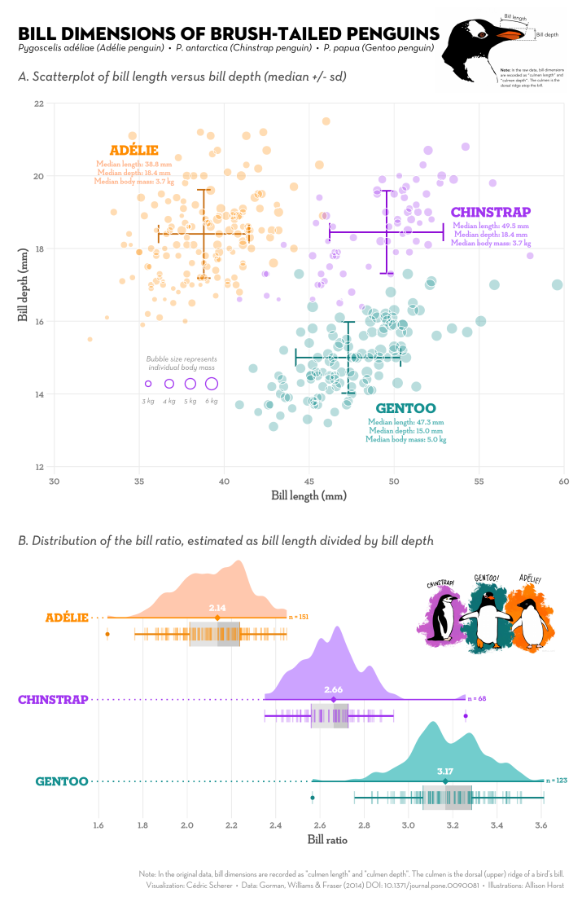
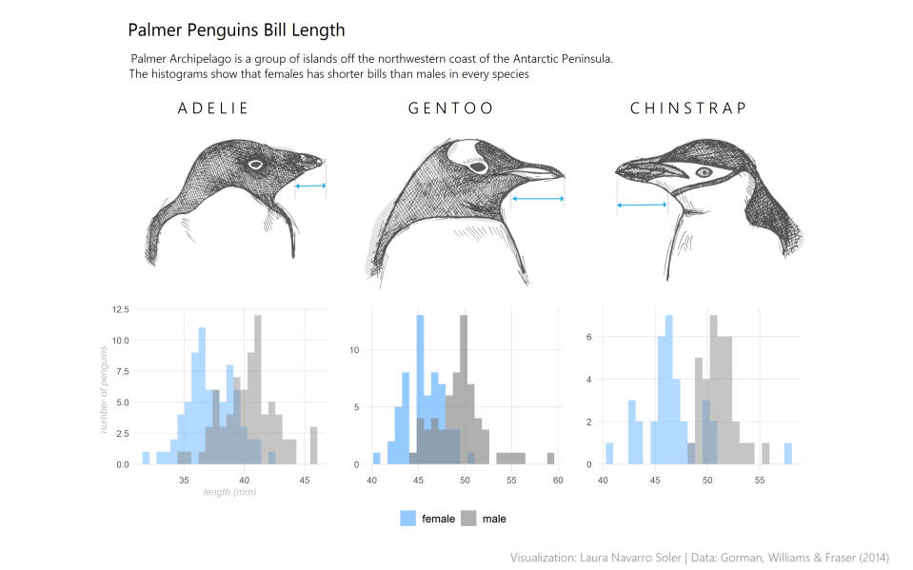

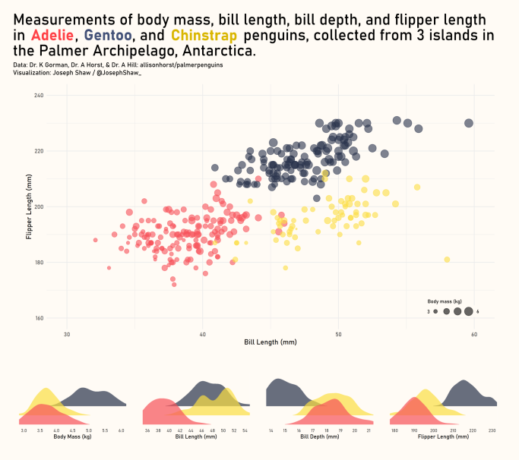

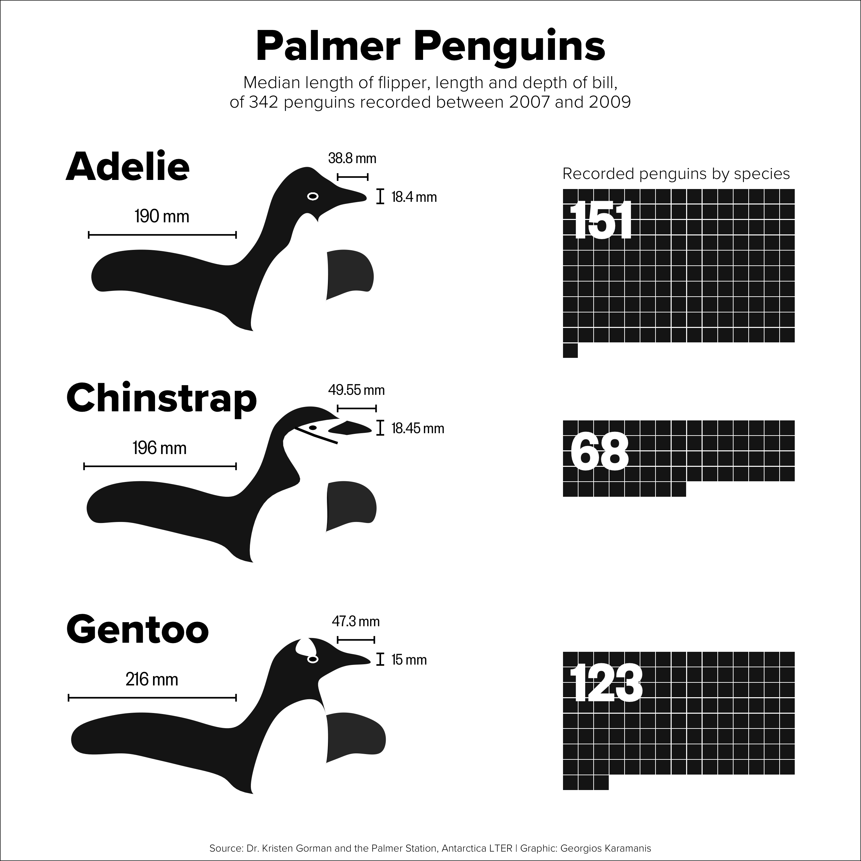
#TidyTuesday Contributions by ← myself ↖ Laura Navarro ↙ Joe Shaw ↓ Georgios
Image by Sean McGrath

Slide 24
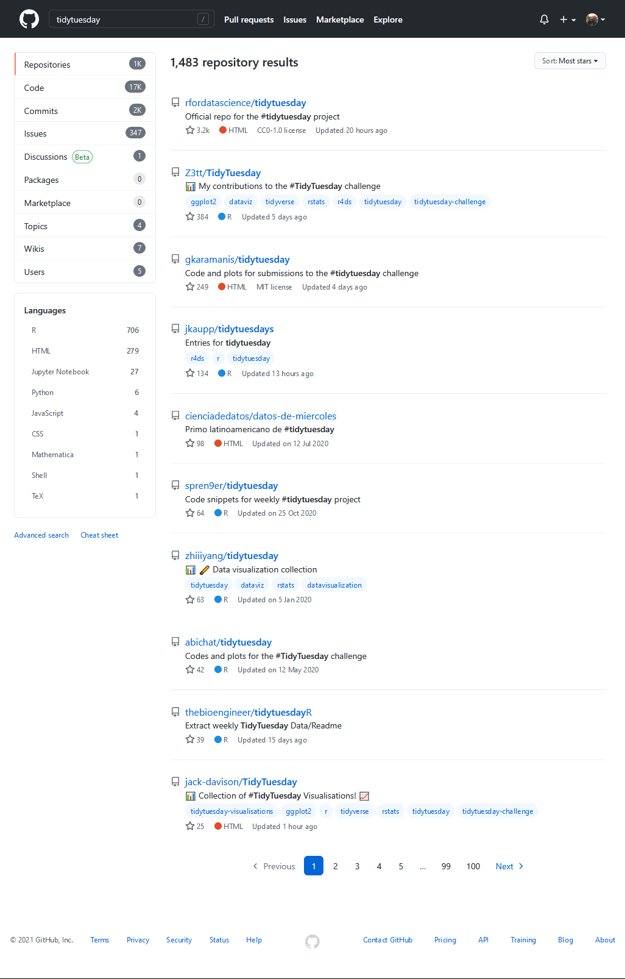
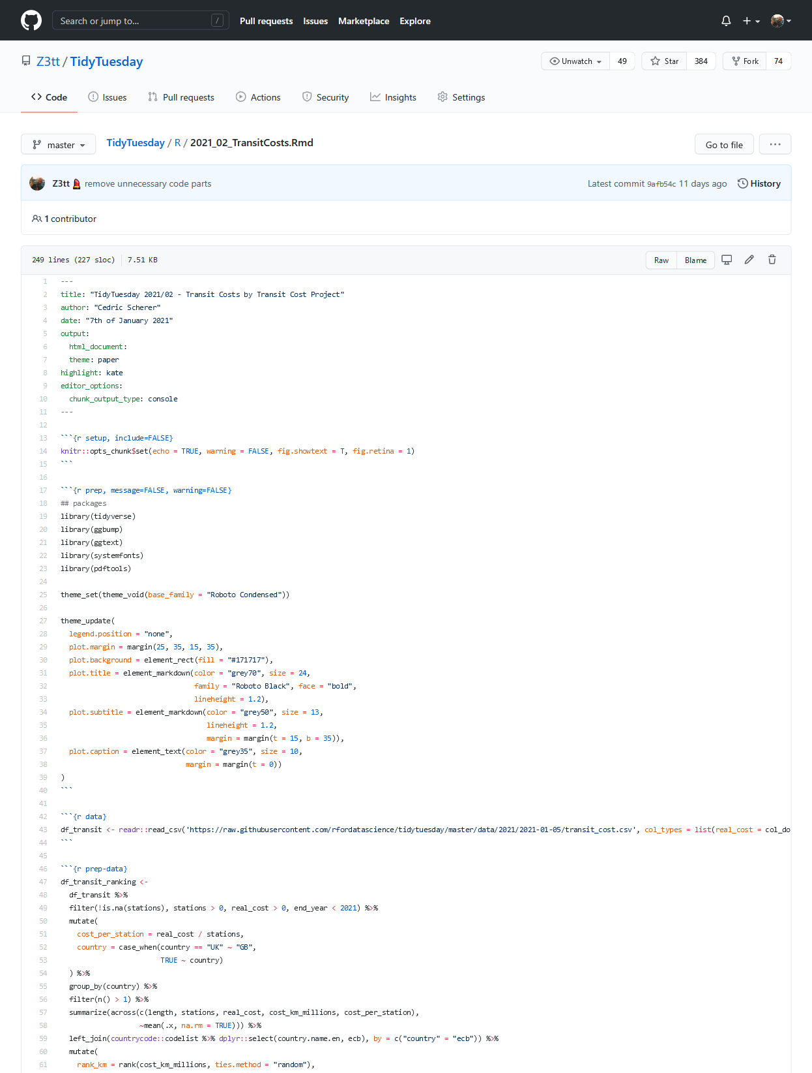
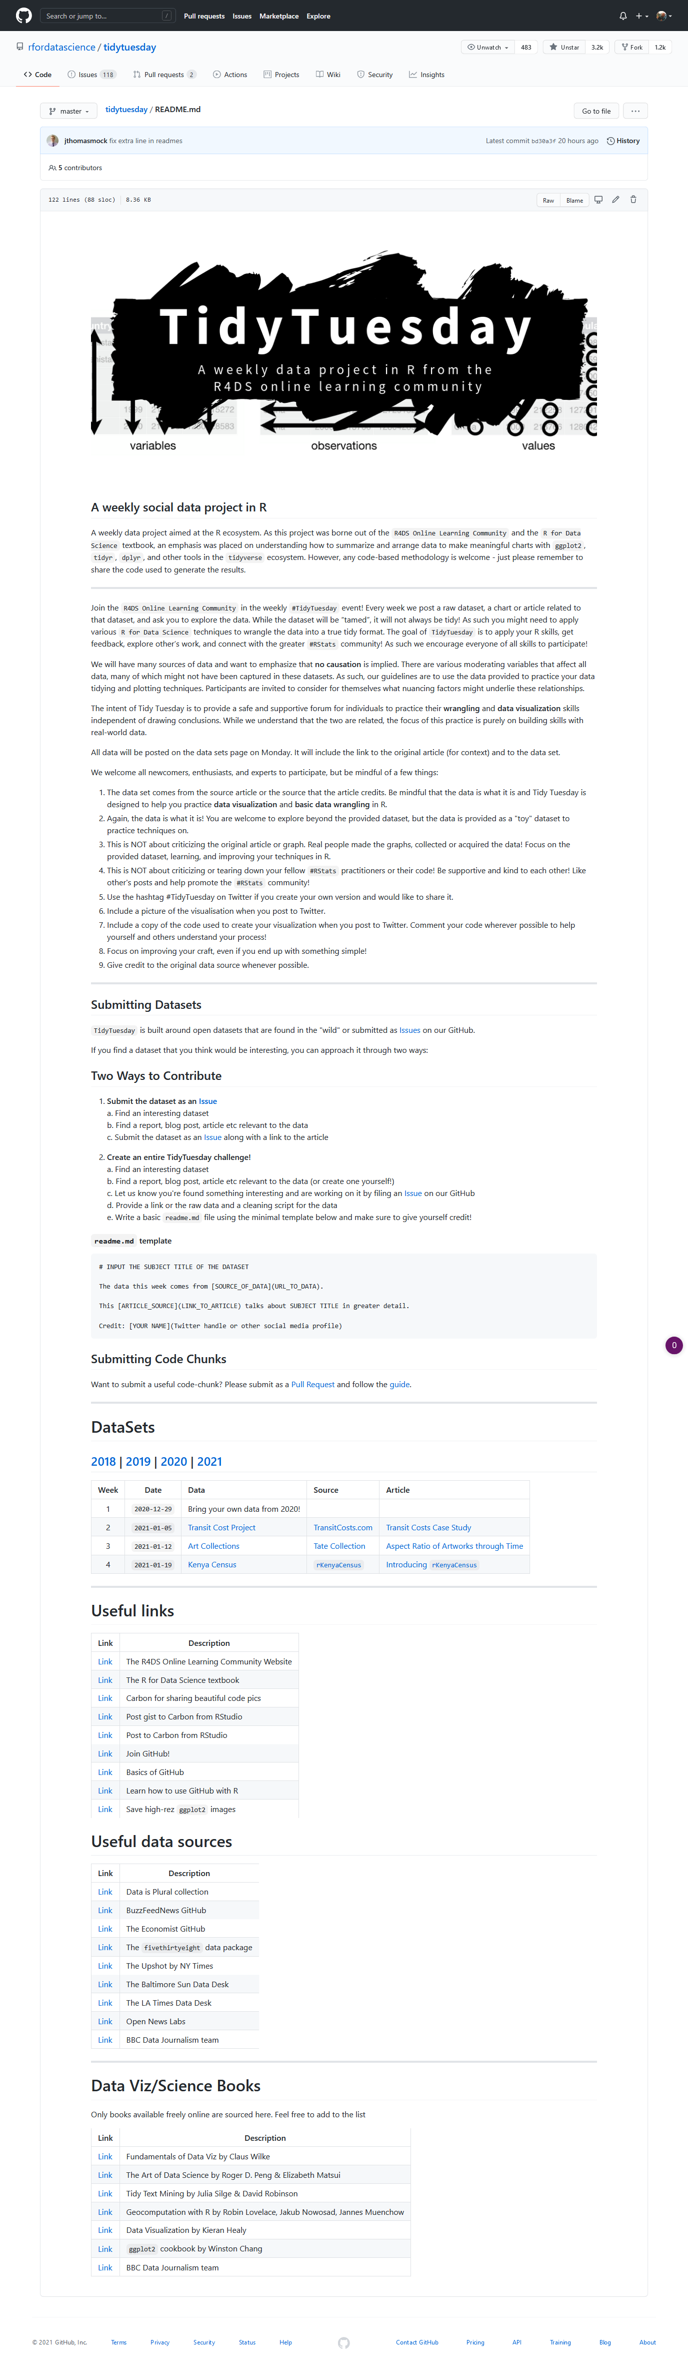



Slide 26

ggplot(penguins, aes(x = bill_length_mm, y = bill_depth_mm)) +
geom_point(aes(color = species, size = body_mass_g), alpha = .5) +
theme_minimal() + labs(title = 'Bill Dimensions of brush-tailed penguins', x = 'Bill length (mm)',
y = 'Bill depth (mm)',
color = 'Species', size = 'Body Mass (g)')
You provide the data, tell ggplot2 how to map variables to aesthetics, what graphical primitives to use, and it takes care of the details.

Slide 27
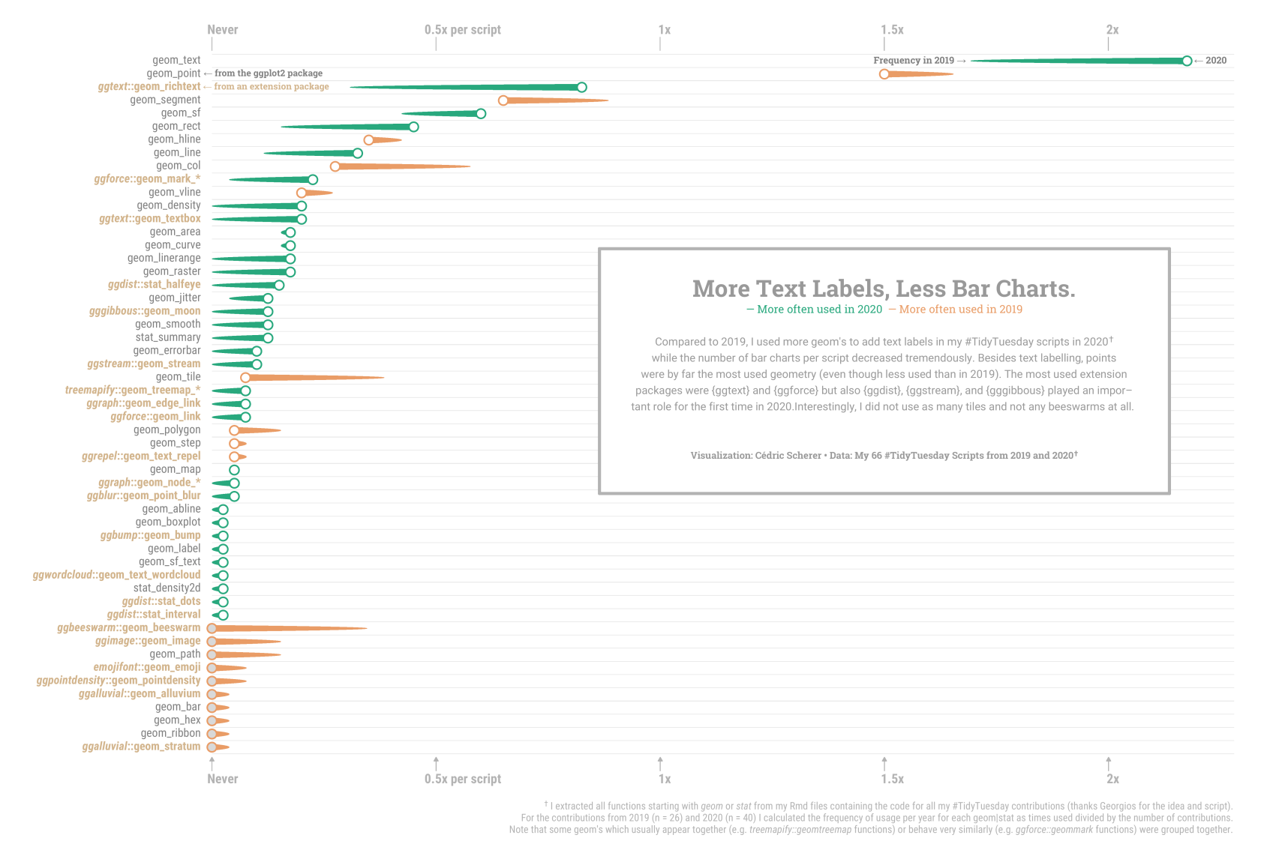

Slide 29
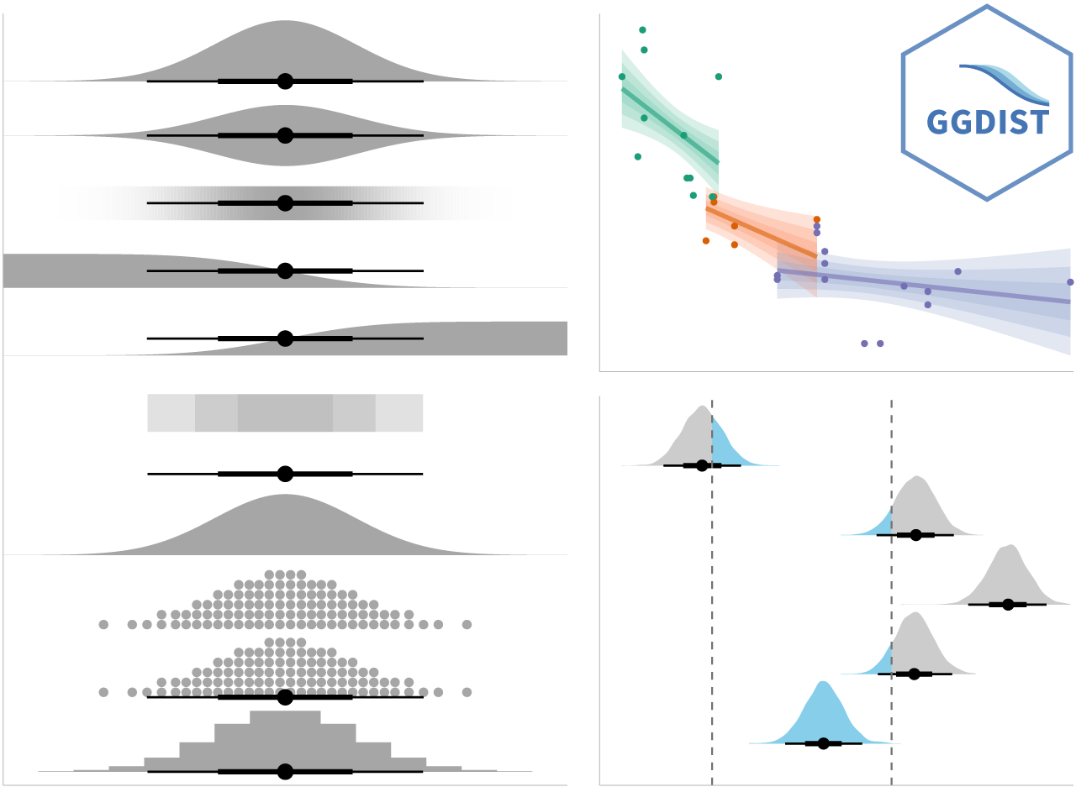
{ggdist} Visualizations of Distributions and Uncertainty

Slide 30
{ggtext}
Improved Text Rendering Support
🔗 wilkelab.org/ggtext

Slide 31
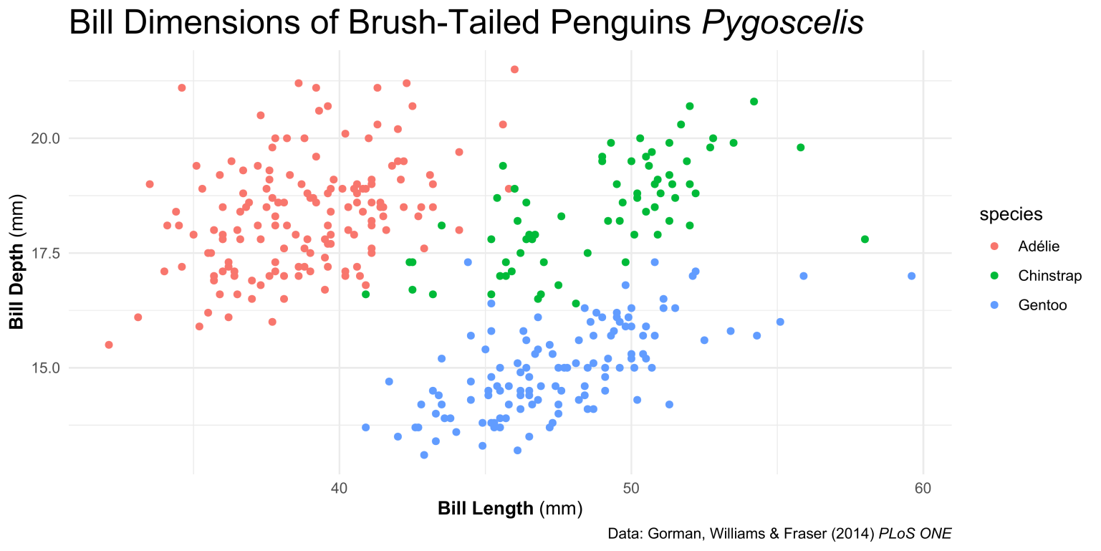
{ggtext} Improved Text Rendering Support
element_markdown() → plot.title, plot.subtitle, plot.caption, axis.title, axis.text, strip.text

Slide 32
{ggtext} Improved Text Rendering Support
element_markdown() → plot.title, plot.subtitle, plot.caption, axis.title, axis.text, strip.text
ggplot(data = df_penguins, aes(x = bill_length_mm, y = bill_depth_mm)) + geom_point(aes(color = species), alpha = .5) + labs(title = "Bill Dimensions of Brush-Tailed Penguins *Pygoscelis*",
caption = "Data: Gorman, Williams & Fraser (2014) *PLoS ONE*",
x = "**Bill Length** (mm)", y = "**Bill Depth** (mm)") +
theme_minimal()

Slide 33
{ggtext} Improved Text Rendering Support
element_markdown() → plot.title, plot.subtitle, plot.caption, axis.title, axis.text, strip.text
ggplot(data = df_penguins, aes(x = bill_length_mm, y = bill_depth_mm)) + geom_point(aes(color = species), alpha = .5) + labs(title = "Bill Dimensions of Brush-Tailed Penguins *Pygoscelis*",
caption = "Data: Gorman, Williams & Fraser (2014) *PLoS ONE*",
x = "**Bill Length** (mm)", y = "**Bill Depth** (mm)") +
theme_minimal() +
theme(plot.title = element_markdown(),
plot.caption = element_markdown(),
axis.title.x = element_markdown(),
axis.title.y = element_markdown())

Slide 34
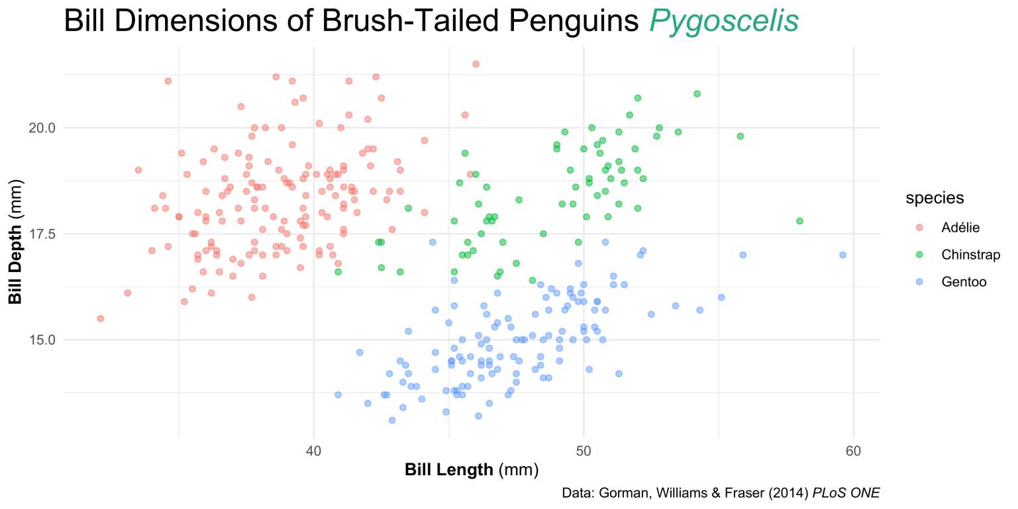
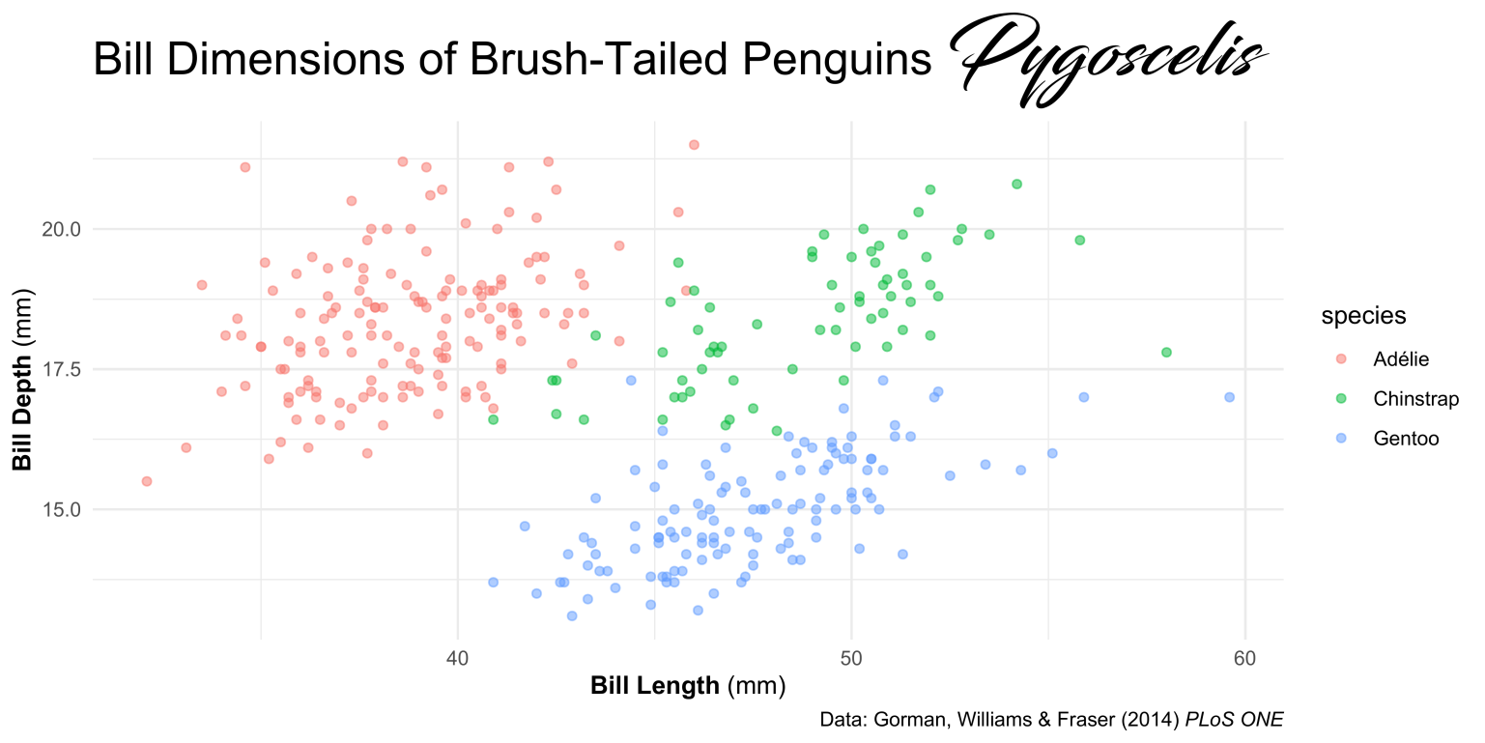
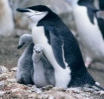
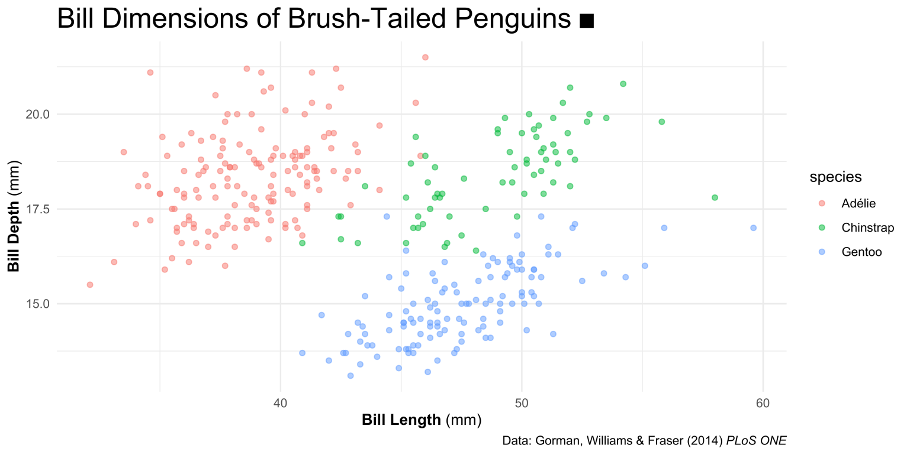
{ggtext} Improved Text Rendering Support
<i style='color:#28A87D;'>Pygoscelis</i>
<b style='font-size:32pt;font-family:blacksword;'>Pygoscelis</b>
<img src='https://cedricscherer.com/img/pygoscelis.jpg'‚ width='10'/>

Slide 35
{ggtext} Improved Text Rendering Support
<i style='color:#28A87D;'>Pygoscelis</i>
<b style='font-size:32pt;font-family:blacksword;'>Pygoscelis</b>
<img src='https://cedricscherer.com/img/pygoscelis.jpg'‚ width='10'/>

Slide 36
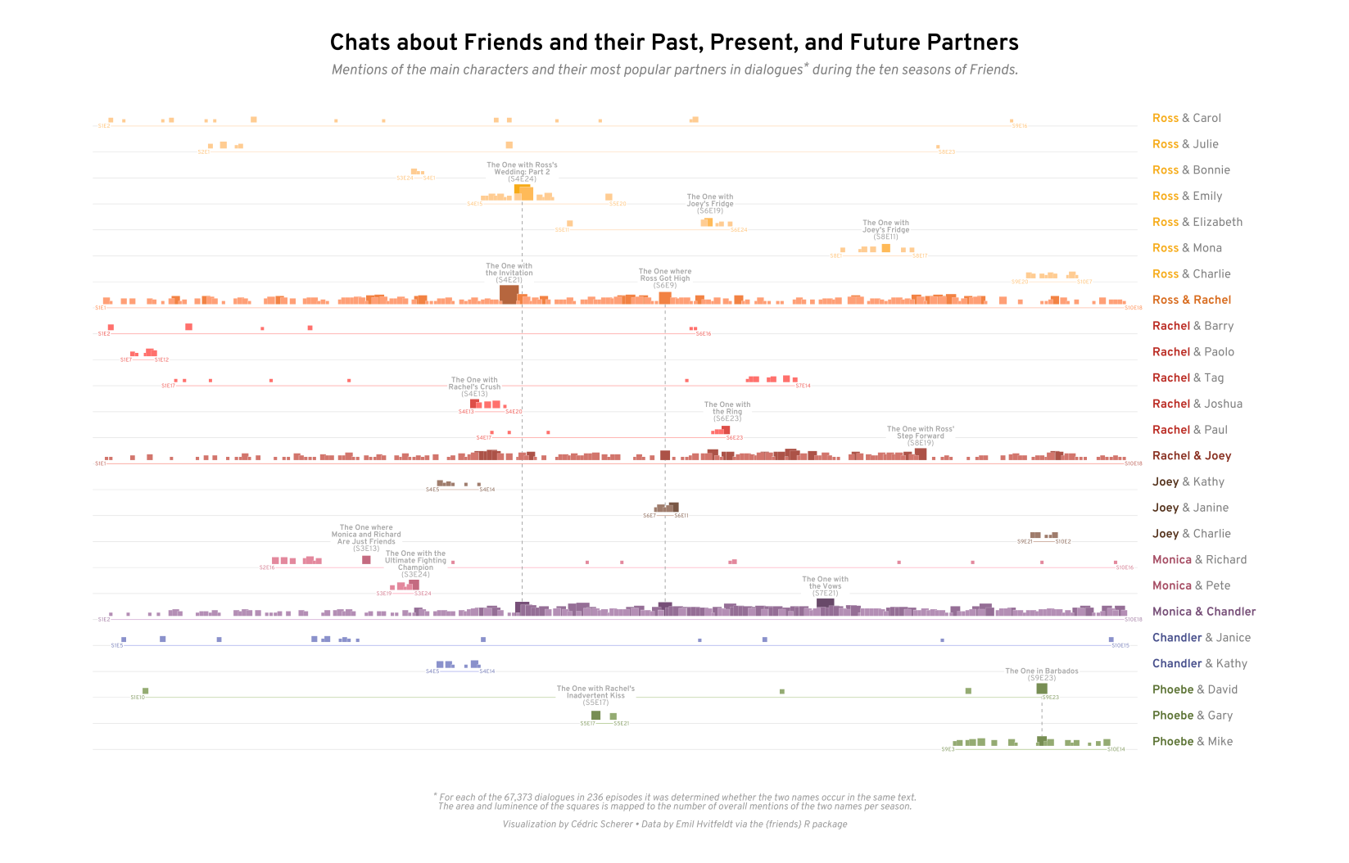
Font Color Font Face
<b style='color:#d86b1d;'>Ross & Rachel</b> <b style='color:#ba2a22;'>Rachel</b> & Barry
Contribution to #TidyTuesday 2020/37

Slide 37
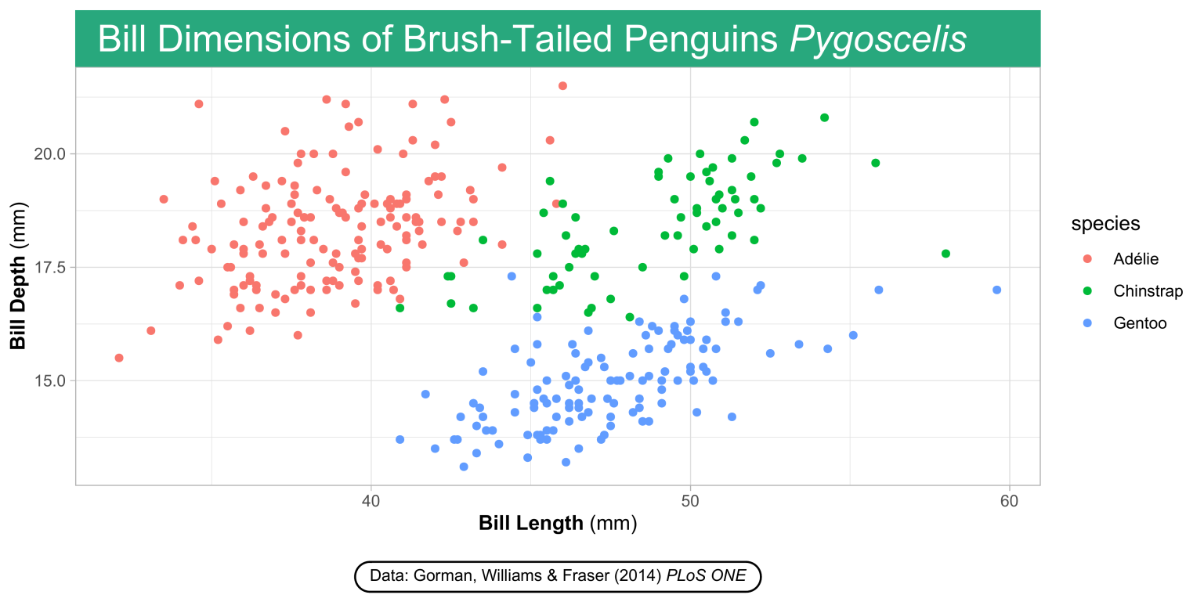
{ggtext} Improved Text Rendering Support
element_textbox* → plot.title, plot.subtitle, plot.caption, axis.title, axis.text, strip.text
plot.title = element_textbox_simple( color = "white", fill = "#28A87D", padding = margin(rep(8, 4)
),
plot.caption = element_textbox_simple(
width = NULL, padding = margin(rep(4, 4), margin = margin(t = 15), linetype = 1, r = grid::unit(8, "pt") )

Slide 38
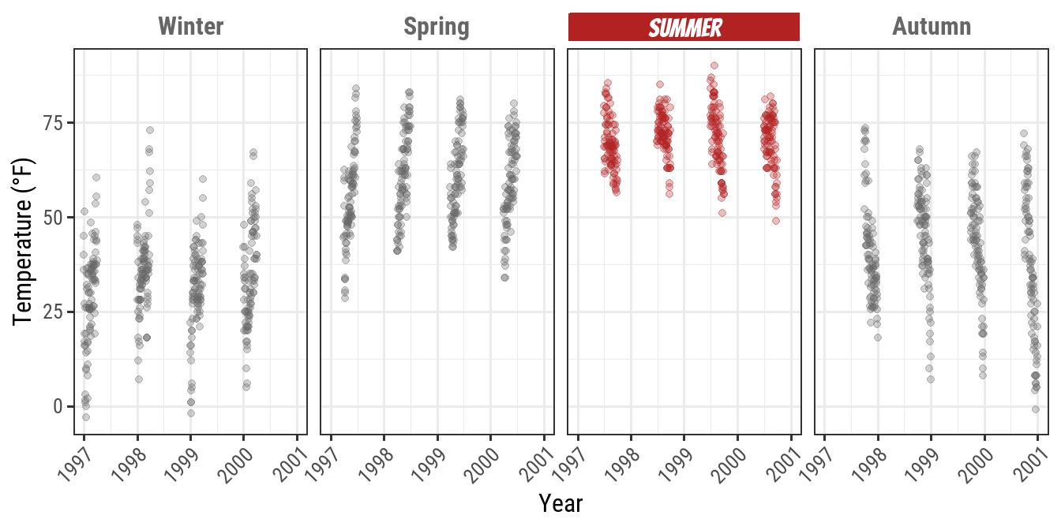
{ggtext} Improved Text Rendering Support
element_textbox* → plot.title, plot.subtitle, plot.caption, axis.title, axis.text, strip.text
→ cedricscherer.com/2019/08/05/a-ggplot2-tutorial-for-beautiful-plotting-in-r/#text

Slide 39
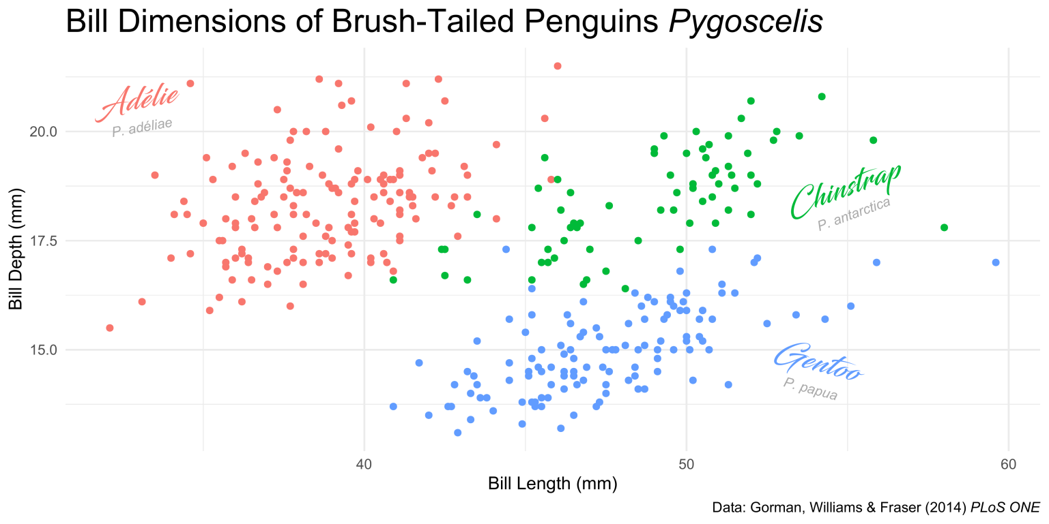
{ggtext} Improved Text Rendering Support
geom_richtext() → rendered labels with rotation

Slide 40
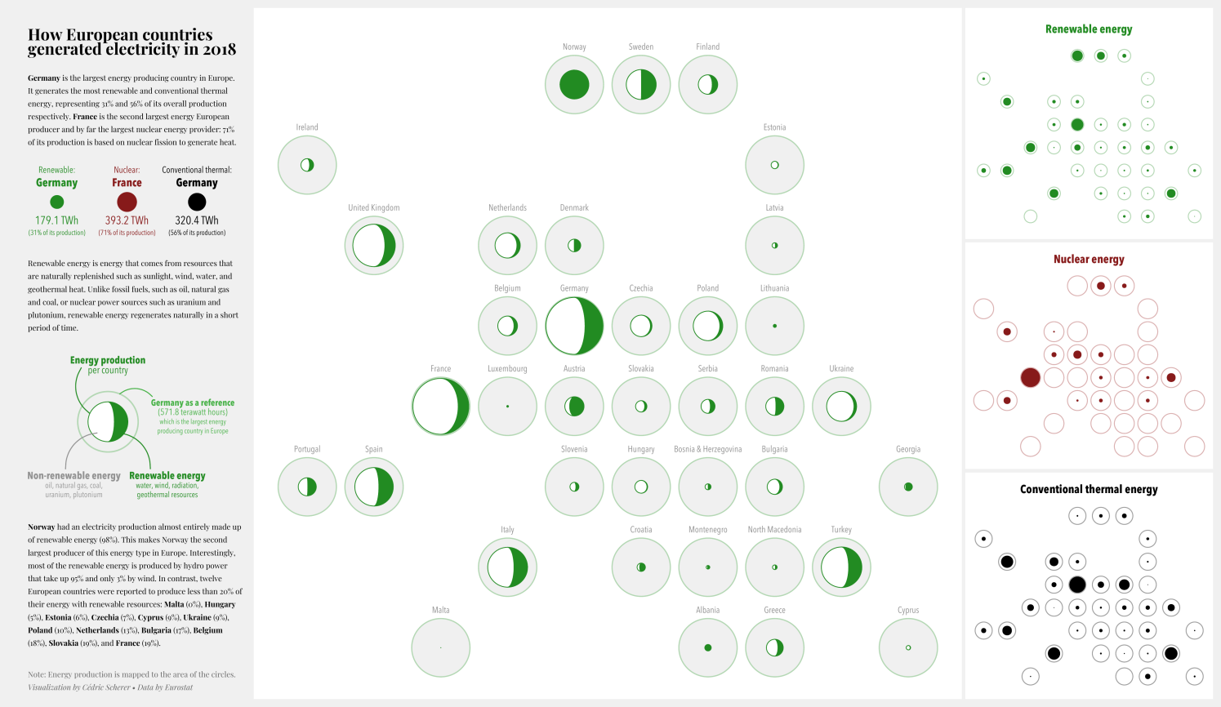
{ggtext} Improved Text Rendering Support
geom_richtext() → rendered labels with rotation
geom_textbox() → rendered text boxes with word-wrapping
Contribution to #TidyTuesday 2020/32

Slide 41
{ggtext} Improved Text Rendering Support
element_markdown() → plot.title, plot.subtitle, plot.caption, axis.title, axis.text, strip.text

Slide 42
{ggtext} Improved Text Rendering Support
element_markdown() → plot.title, plot.subtitle, plot.caption, axis.title, axis.text, strip.text
ggplot(data = df_penguins, aes(x = bill_length_mm, y = bill_depth_mm)) + geom_point(aes(color = species), alpha = .5) + labs(title = "Bill Dimensions of Brush-Tailed Penguins <i style='color:#28A87D;'>Pygoscelis</i>",
caption = "Data: Gorman, Williams & Fraser (2014) *PLoS ONE*",
x = "**Bill Length** (mm)", y = "**Bill Depth** (mm)") +
theme_minimal() +
theme(plot.title = element_markdown(size = 20),
plot.caption = element_markdown(),
axis.title.x = element_markdown(),
axis.title.y = element_markdown())

Slide 43
tibble(
key = c("Chandler", "Joey", "Monica", "Monica & Chandler", "Phoebe", "Rachel", "Rachel & Joey", "Ross", "Ross & Rachel"),
color = c("#48508c", "#55331d", "#a64d64", "#774f78", "#5b7233", "#ba2a22", "#882f20", "#f6ab18", "#d86b1d")
)
Font Color Font Face
key | color
Ross | #f6ab18
Chandler | #48508c
Ross & Rachel | #d86b1d

Slide 44
tibble(
key = c("Chandler", "Joey", "Monica", "Monica & Chandler", "Phoebe", "Rachel", "Rachel & Joey", "Ross", "Ross & Rachel"),
color = c("#48508c", "#55331d", "#a64d64", "#774f78", "#5b7233", "#ba2a22", "#882f20", "#f6ab18", "#d86b1d")
) %>% right_join(df_friends, by = "key")
Font Color Font Face
key | color | partners | episode
Ross | #f6ab18 | Ross & Carol | S01E01
Chandler | #48508c | Chandler & Janice | S01E03
Ross & Rachel | #d86b1d | Ross & Rachel | S01E04

Slide 45
tibble(
key = c("Chandler", "Joey", "Monica", "Monica & Chandler", "Phoebe", "Rachel", "Rachel & Joey", "Ross", "Ross & Rachel"),
color = c("#48508c", "#55331d", "#a64d64", "#774f78", "#5b7233", "#ba2a22", "#882f20", "#f6ab18", "#d86b1d")
) %>% right_join(df_friends, by = "key") %>%
mutate(partners = if_else(
key %in% c("Ross & Rachel", "Rachel & Joey",
"Monica & Chandler"),
glue::glue("<b style='color:{color};'> {partners}</b>"),
str_replace(partners, key, glue::glue("<b style='color:{color};'> {key}</b>"))
))
key | color | partners
Ross | #f6ab18 | Ross & Carol
Chandler | #48508c | Chandler & Janice
Ross & Rachel | #d86b1d | Ross & Rachel
else
else
if
Font Color Font Face

Slide 46
tibble(
key = c("Chandler", "Joey", "Monica", "Monica & Chandler", "Phoebe", "Rachel", "Rachel & Joey", "Ross", "Ross & Rachel"),
color = c("#48508c", "#55331d", "#a64d64", "#774f78", "#5b7233", "#ba2a22", "#882f20", "#f6ab18", "#d86b1d")
) %>% right_join(df_friends, by = "key") %>%
mutate(partners = if_else(
key %in% c("Ross & Rachel", "Rachel & Joey",
"Monica & Chandler"),
glue::glue("<b style='color:{color};'> {partners}</b>"),
str_replace(partners, key, glue::glue("<b style='color:{color};'> {key}</b>"))
))
key | color | partners
Ross | #f6ab18 | Ross & Carol
Chandler | #48508c | Chandler & Janice
Ross & Rachel | #d86b1d | <b style='color:#d86b1d;'>Ross & Rachel</b>
else
else
Font Color Font Face

Slide 47
tibble(
key = c("Chandler", "Joey", "Monica", "Monica & Chandler", "Phoebe", "Rachel", "Rachel & Joey", "Ross", "Ross & Rachel"),
colors = c("#48508c", "#55331d", "#a64d64", "#774f78", "#5b7233", "#ba2a22", "#882f20", "#f6ab18", "#d86b1d")
) %>% right_join(df_friends, by = "key") %>%
mutate(partners = if_else(
key %in% c("Ross & Rachel", "Rachel & Joey",
"Monica & Chandler"),
glue::glue("<b style='color:{color};'> {partners}</b>"),
str_replace(partners, key, glue::glue("<b style='color:{color};'> {key}</b>"))
))
key | color | partners
Ross | #f6ab18 | <b style='color:#f6ab18;'>Ross</b> & Carol
Chandler | #48508c | <b style='color:#48508c;'>Chandler</b> & Janice
Ross & Rachel | #d86b1d | <b style='color:#d86b1d;'>Ross & Rachel</b>
Font Color Font Face

Slide 48
Font Color Font Face
label = if_else(
key %in% c("Ross & Rachel", "Rachel & Joey", "Monica & Chandler"),
glue::glue("<b style='color:{color};'> {partners}</b>"),
stringr::str_replace(partners, key, glue::glue("<b style='color:{color};'>{key}</b>"))
)
partners | key | color | label
Ross & Rachel | Ross & Rachel | #d86b1d
Chandler & Janice | Chandler | #48508c
Ross & Carol | Ross | #f6ab18
Contribution to #TidyTuesday 2020/37

Slide 49
Font Color Font Face
label = if_else(
key %in% c("Ross & Rachel", "Rachel & Joey", "Monica & Chandler"),
glue::glue("<b style='color:{color};'>{partners}</b>"),
stringr::str_replace(partners, key, glue::glue("<b style='color:{color};'>{key}</b>"))
)
partners | key | color | label
Ross & Rachel | Ross & Rachel | #d86b1d | <b style='color:#d86b1d;'>Ross & Rachel</b>
Chandler & Janice | Chandler | #48508c
Ross & Carol | Ross | #f6ab18
Contribution to #TidyTuesday 2020/37

Slide 50
Font Color Font Face
label = if_else(
key %in% c("Ross & Rachel", "Rachel & Joey", "Monica & Chandler"),
glue::glue("<b style='color:{color};'>{partners}</b>"),
stringr::str_replace(partners, key, glue::glue("<b style='color:{color};'>{key}</b>"))
)
partners | key | color | label
Ross & Rachel | Ross & Rachel | #d86b1d | <b style='color:#d86b1d;'>Ross & Rachel</b>
Chandler & Janice | Chandler | #48508c | <b style='color:#48508c;'>Chandler</b> & Janice
Ross & Carol | Ross | #f6ab18 | <b style='color:#f6ab18;'>Ross</b> & Carol
Contribution to #TidyTuesday 2020/37

Slide 51
Font Family Font Size Font Face Lineheight

Slide 52
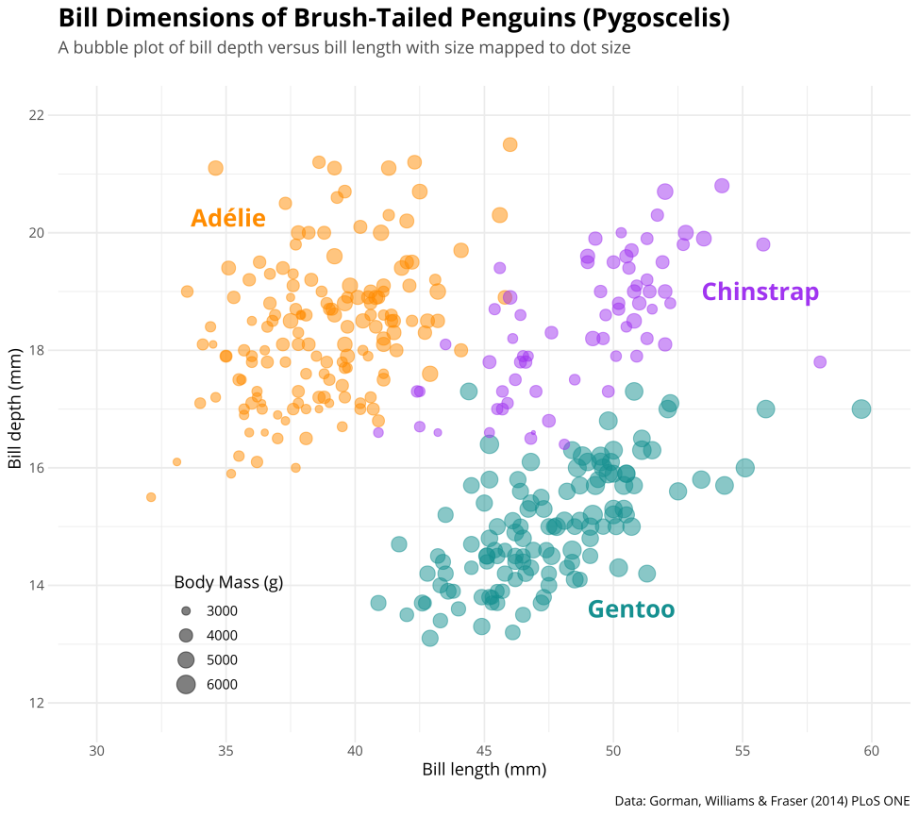
Left-Aligned Title?
theme(plot.title = element_text(hjust = 0))

Slide 53
Left-Aligned Title
Default
theme(plot.title.position = 'panel')

Slide 54
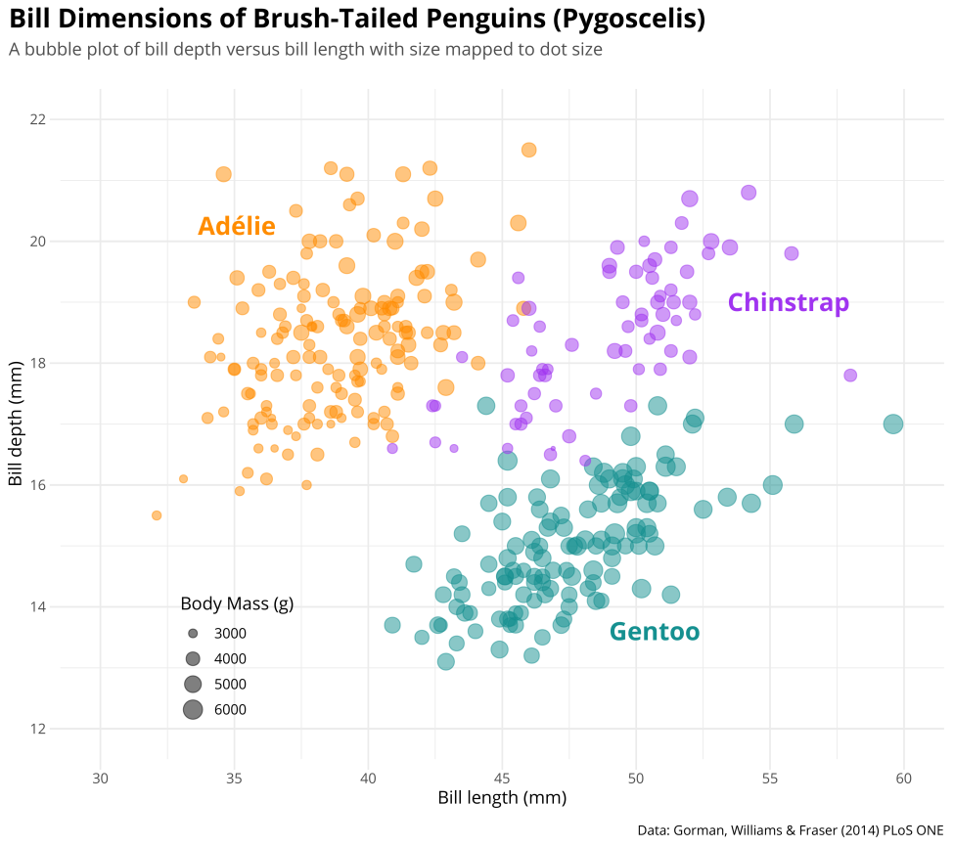
Left-Aligned Title
Default
Better
theme(plot.title.position = 'panel')
theme(plot.title.position = 'plot')

Slide 55
Legend Design
Default
guides(size = guide_legend())

Slide 56

Legend Design
Customized
guides(size = guide_legend(direction = 'horizontal', title.position = "top", title.hjust = .5, label.position = "bottom")))

Slide 57
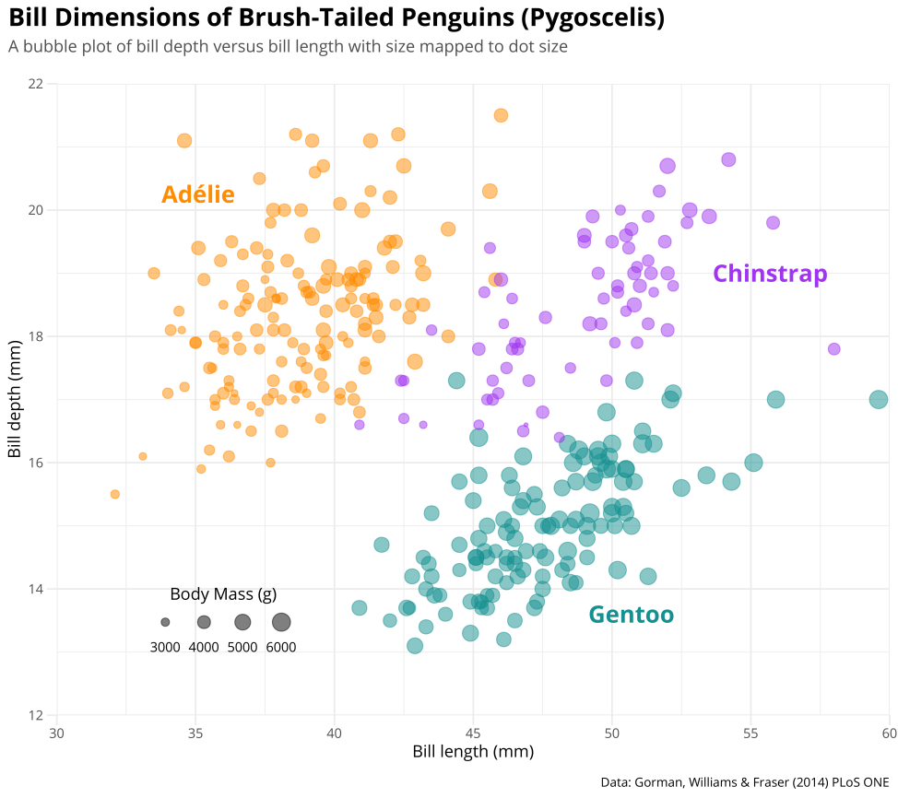
Legend Design
Customized
coord_cartesian(expand = c(0, 0), clip = 'off')

Slide 58
Limit Expansion
Default
Without
coord_cartesian(expand = TRUE))
coord_cartesian(expand = FALSE))

Slide 59
1
-
Left-Aligned Title
4
Adding Images
5
Fancy Points
2
Legend Design
3
6
Origin
Text Modification

Slide 60
1
-
theme(plot.position = 'plot')
4
geom_text(aes(x, y, label = species))
annotation_custom(grid::rasterGrob(img))
5
geom_point(shape = 21, color = NA) + geom_point(shape = 21, fill = NA)
2
theme(legend.position = c(.2,.2))
3
6
coord_cartesian(expand = c(0, 0), clip = 'off') + scale_*_continuous(limits = c(30, 60))
ggtext::geom_richtext() + theme(plot.title = element_markdown())

Slide 61
1
-
theme(plot.position = 'plot')
6
annotation_custom(grid::rasterGrob(img))
theme(legend.position = c(.2,.2))
7
2
geom_point(shape = 21, color = NA) + geom_point(shape = 21, fill = NA)
3
8
coord_cartesian(clip = 'off‚ expand = c(0, 0))
ggtext::geom_richtext() + theme(plot.title = element_markdown())
4
ggdist::stat_halfeye() + geom_point(shape = '|')
9
5
stat_summary(geom = "linerange", fun.min = function(x) 0, fun.max = function(x) median(x))
scale_*_continuous(breaks = 1:3, labels = unique(penguins$species))

Slide 62
1
-
theme(plot.position = 'plot')
5
annotation_custom(grid::rasterGrob(img))
theme(legend.position = c(.2,.2))
6
2
geom_point(shape = 21, color = NA) + geom_point(shape = 21, fill = NA)
3
7
coord_cartesian(clip = 'off‚ expand = c(0, 0)) + scale_*_continuous(limits = c(30, 60))
ggtext::geom_richtext() + theme(plot.title = element_markdown())
4
8
scale_*_continuous(breaks = 1:3, labels = unique(penguins$species))
ggdist::stat_halfeye() + geom_point(shape = '|')

Slide 63
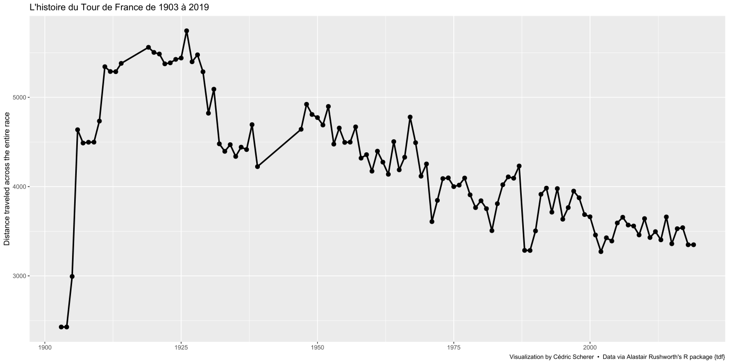
You provide the data, tell ggplot2 how to map variables to aesthetics, what graphical primitives to use, and it takes care of the details.

Slide 64
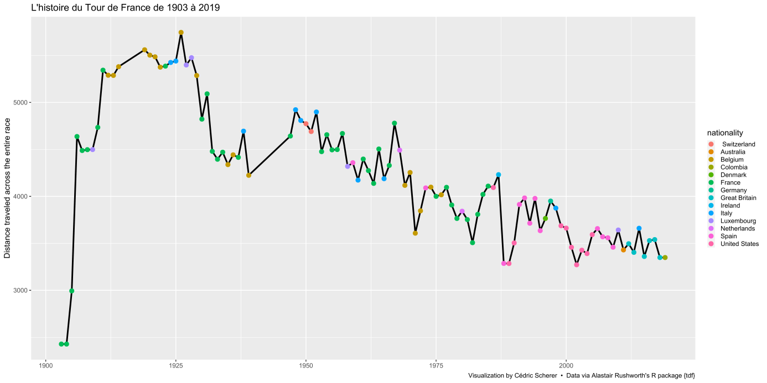
You provide the data, tell ggplot2 how to map variables to aesthetics, what graphical primitives to use, and it takes care of the details.

Slide 65

You provide the data, tell ggplot2 how to map variables to aesthetics, what graphical primitives to use, and it takes care of the details.

Slide 66

You provide the data, tell ggplot2 how to map variables to aesthetics, what graphical primitives to use, and it takes care of the details.

Slide 67

You provide the data, tell ggplot2 how to map variables to aesthetics, what graphical primitives to use, and it takes care of the details.

Slide 68
You provide the data, tell ggplot2 how to map variables to aesthetics, what graphical primitives to use, and it takes care of the details.

Slide 69





{ggforce} Fancy Annotations
geom_mark_*() → fancy text labels for single or multiple points
→ show all groups or highlight interesting parts
geom_mark_hull()
geom_mark_ellipsoid()
geom_mark_circle()
geom_mark_rect()

Slide 70


Jake Kaupp, Contribution to #TidyTuesday 2020/10

Slide 71

ggtitle('*Pygoscelis*') + theme(plot.title = element_markdown())
1
-
3
theme(plot.position = 'plot')
4
theme(legend.position = 'top') + guide(color = guide_colorbar()
7
annotation_custom(grid::rasterGrob(img))
5
theme(plot.margin = margin(t, r, b, l)
2
ggforce::geom_mark_*()
6
coord_cartesian(expand = c(0, 0),
clip = 'off')

Slide 72



www.r-graph-gallery.com
www.data-to-viz.com

Slide 73







Personal Work
Joe Shaw
David Zumbach
Maia Pelletier
Torsten Sprenger
Georgios Karamanis
Personal Work
You provide the data, tell ggplot2 how to map variables to aesthetics, what graphical primitives to use, and it takes care of the details.

Slide 74


{ggforce}
Providing Missing Functionality to ggplot2
🔗 ggforce.data-imaginist.com
Notes:
Next up is ggforce, a package developed by Thomas Pedersen that provides a vast range of functionailty to ggplot.

Slide 75

geom_bspline_closed()
Georgios Karamanis, Contribution to #TidyTuesday 2020/31

Slide 76
{gggibbous}
Moon charts for ggplot2
🔗 github.com/mnbram/gggibbous

Slide 77




doi.org/10.2312/evs.20191163

Slide 78


{gggibbous} Moon charts
Package example (github.com/mnbram/gggibbous)
Contribution to #TidyTuesday 2020/25

Slide 79


Notes:
In this contribution, I used a geom_textbox_simple to add the title and subtitle in one go and geom_richtext for the labelling of individual astronauts with different text size and formatting.

Slide 80

Jake Kaupp
Notes:
This way you can create charts with wonderful and detailed text label as illustrated by Jake Kaupp in this example…

Slide 81





Palmer Penguins
🔗 github.com/allisonhorst/palmerpenguins
ggforce::geom_mark_circle()
ggtext::element_markdown()
ggtext

Slide 82

{ggtext} Improved Text Rendering Support
element_markdown() → formatted text elements, e.g. titles, caption, axis text, striptext
geom_richtext() → formatted text labels with 360° rotation
Notes:
geom_richtext allows to draw text labels similar to geom_text but with rendered text and, if you like, full 360° rotation.

Slide 83

{ggtext} Improved Text Rendering Support
element_markdown() → formatted text elements, e.g. titles, caption, axis text, striptext
geom_richtext() → formatted text labels with 360° rotation
element_textbox() and element_textbox_simple() → formatted text boxes with word wrapping
Notes:
Similar to element_markdown, element_textbox can be use to replace text elements and add a box with word wrapping as the title and the caption illustrate…

Slide 84

{ggtext} Improved Text Rendering Support
element_markdown() → formatted text elements, e.g. titles, caption, axis text, striptext
geom_richtext() → formatted text labels with 360° rotation
element_textbox() and element_textbox_simple() → formatted text boxes with word wrapping
geom_textbox() → formatted text boxes with word wrapping
Notes:
… and geom_textbox provides the same functionaility for text labels.

